Slide 1

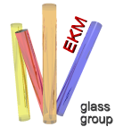
P. Lunkenheimer, M. Köhler, S. Kastner, and A. Loidl
Center for Electronic Correlations and Magnetism
Experimental Physics V, University of Augsburg, Germany
Fast dynamics of glass forming liquids
Broadband dielectric response of glass formers
The fast process of MCT in dielectric spectroscopy
Glycerol with LiCl
Correlation of α and fast process

Slide 2
Experimental Details
Measurement of dielectric constant and complex conductivity
Parameters: frequency, temperature (0.1K - 1500K), ac-voltage (<2000V), magnetic field (<14T)
Extremely broad frequency range: 10⁻⁶ Hz < ν < 10¹⁵ Hz
for details, see U. Schneider, P. Lunkenheimer, A. Pimenov, R. Brand, and A. Loidl, Ferroelectrics 249, 89 (2001)

Slide 3
Glassy Dynamics
Broadband dielectric response of dipolar glassforming liquids:
α-relaxation – structural relaxation → viscosity
excess wing = slow β
"Johari-Goldstein process"
fast process: cage effect
explained by mode-coupling theory (Götze et al.)
boson peak:
vibrational excitations (?)
intramolecular modes
P. Lunkenheimer and A. Loidl, Contemp. Phys. 41, 15 (2000); Chem. Phys. 284, 205 (2002)

Slide 4
Glassy Dynamics: Temperature Dependence
P. Lunkenheimer et al., in Structural Glasses and Supercooled Liquids, edited by P.G. Wolynes and V. Lubchenko (Wiley, Hoboken, 2012)

Slide 5
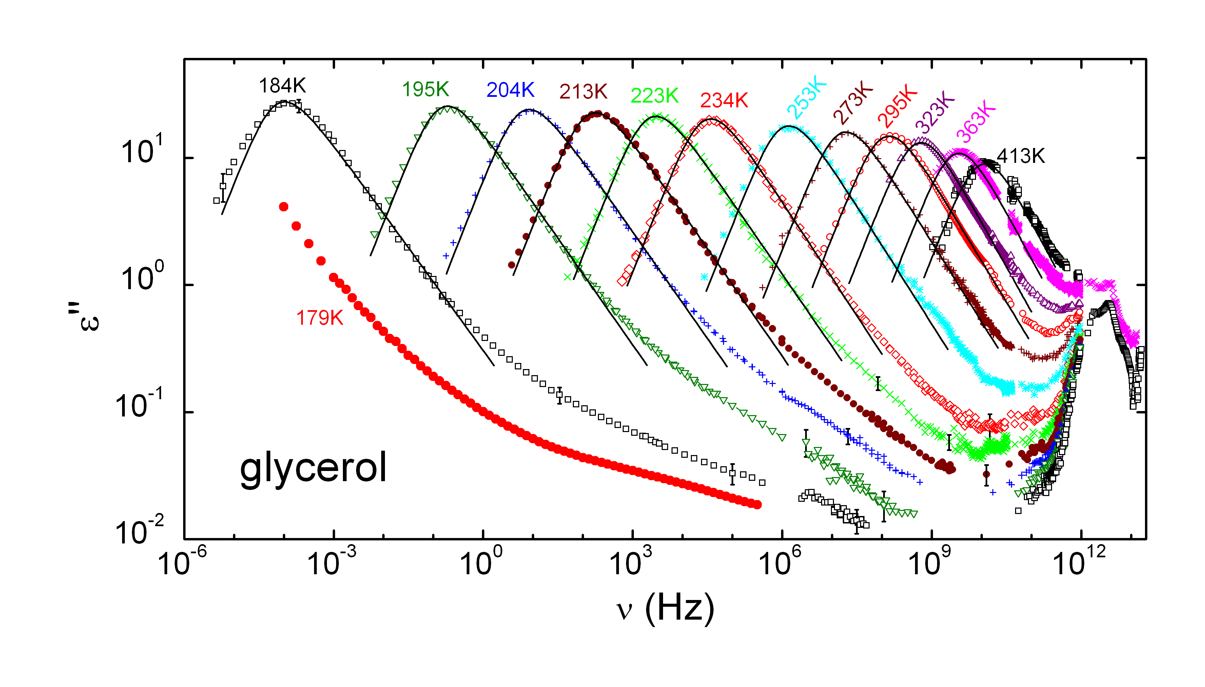
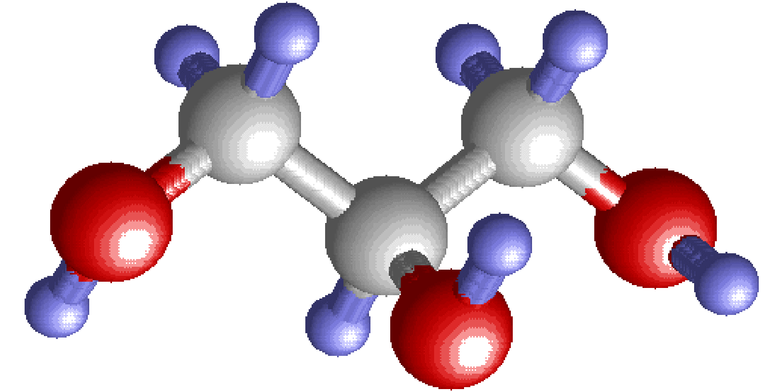
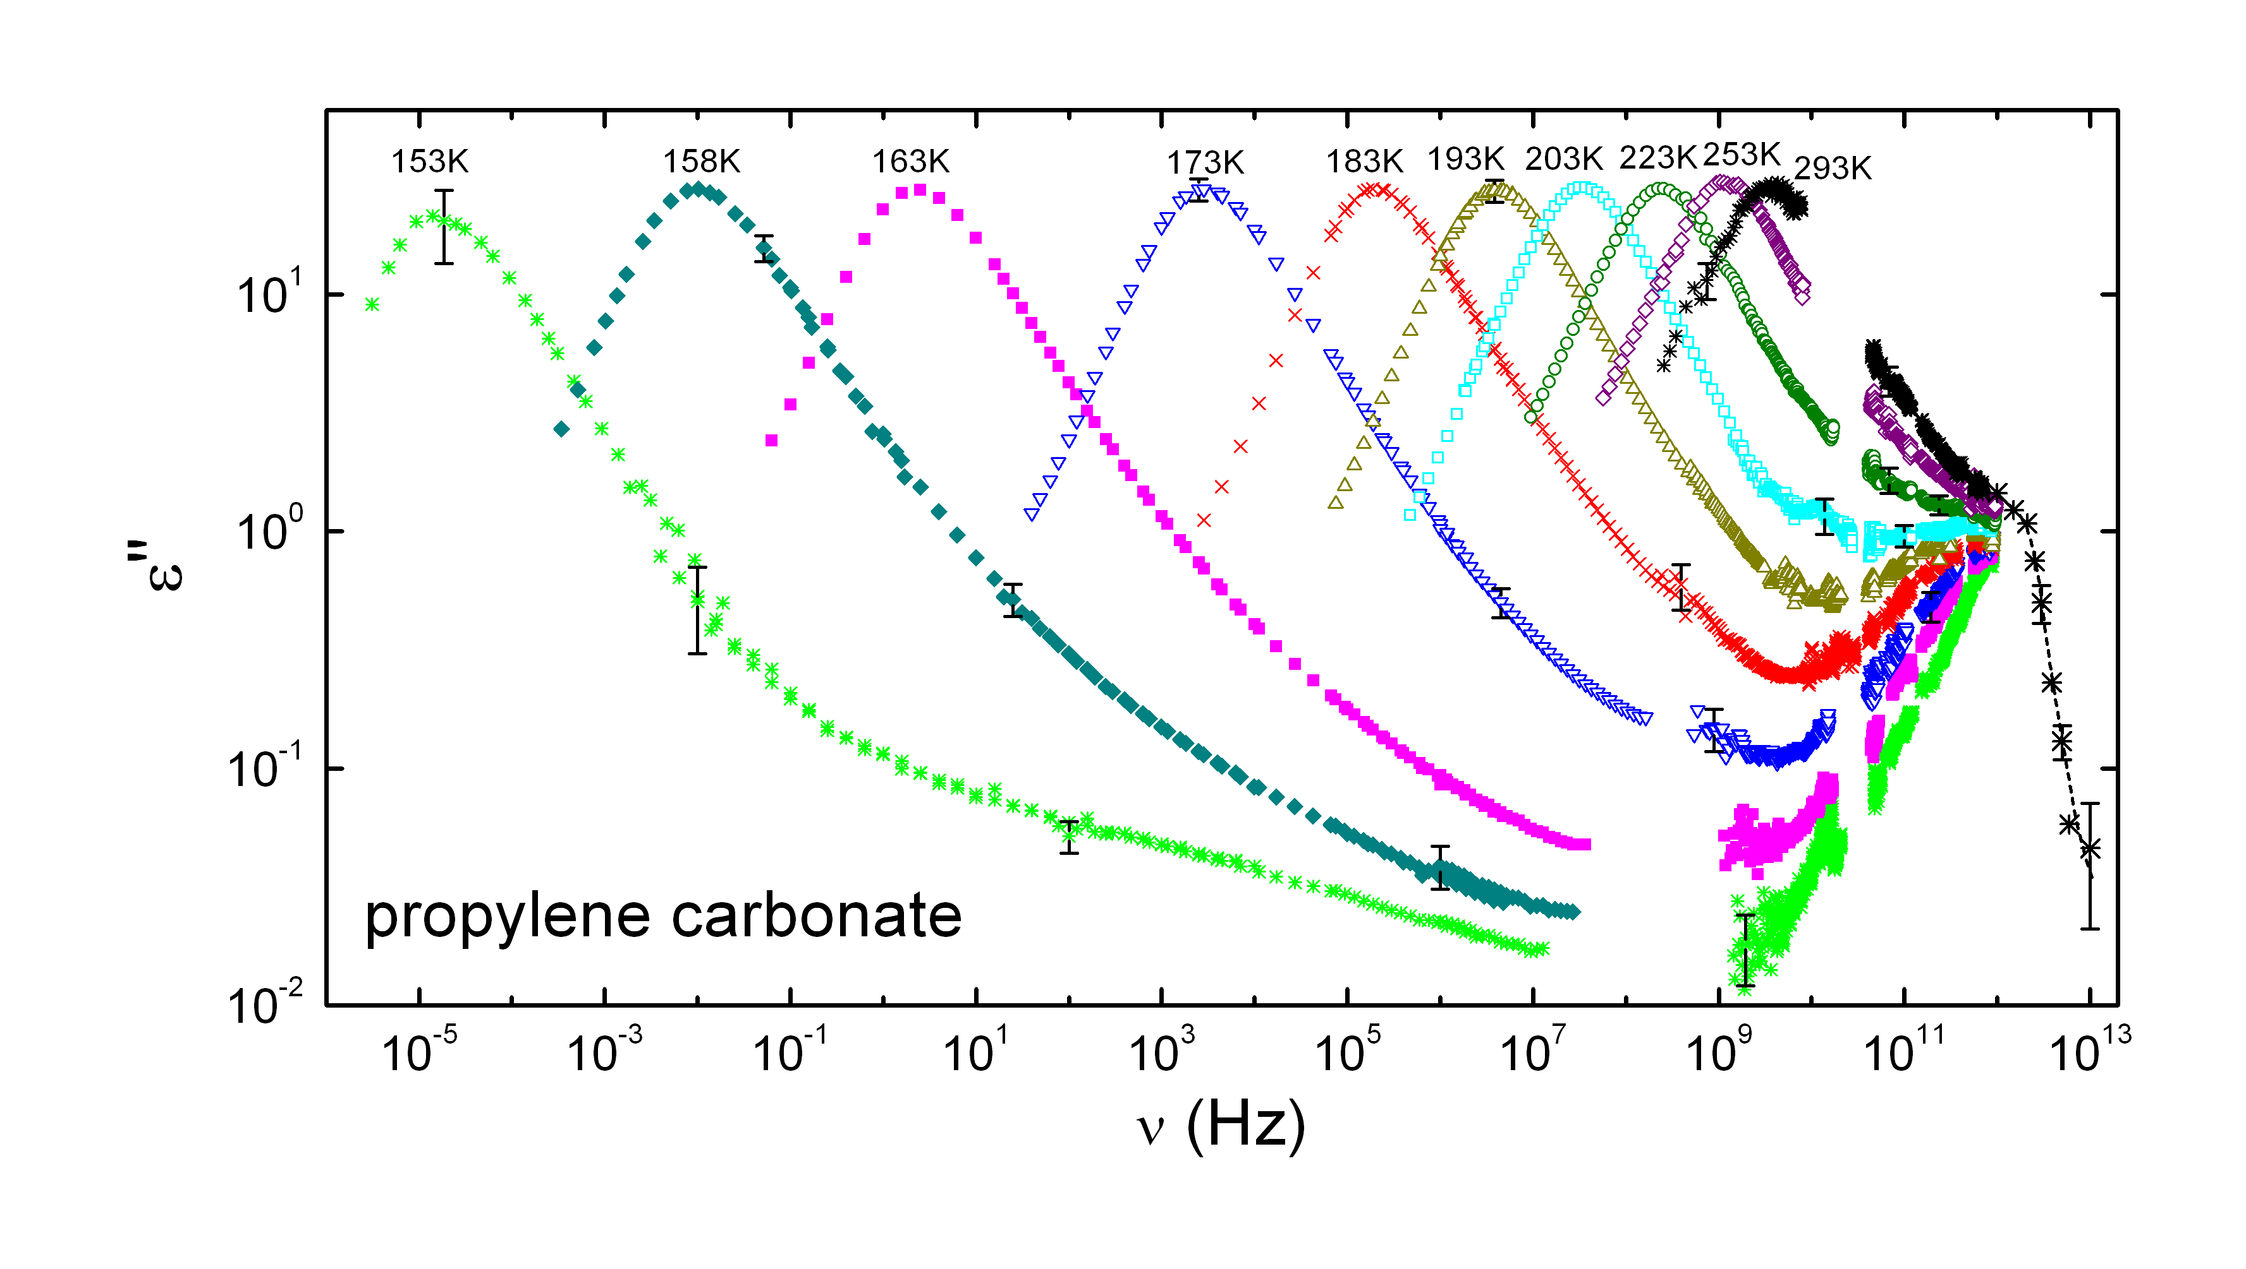
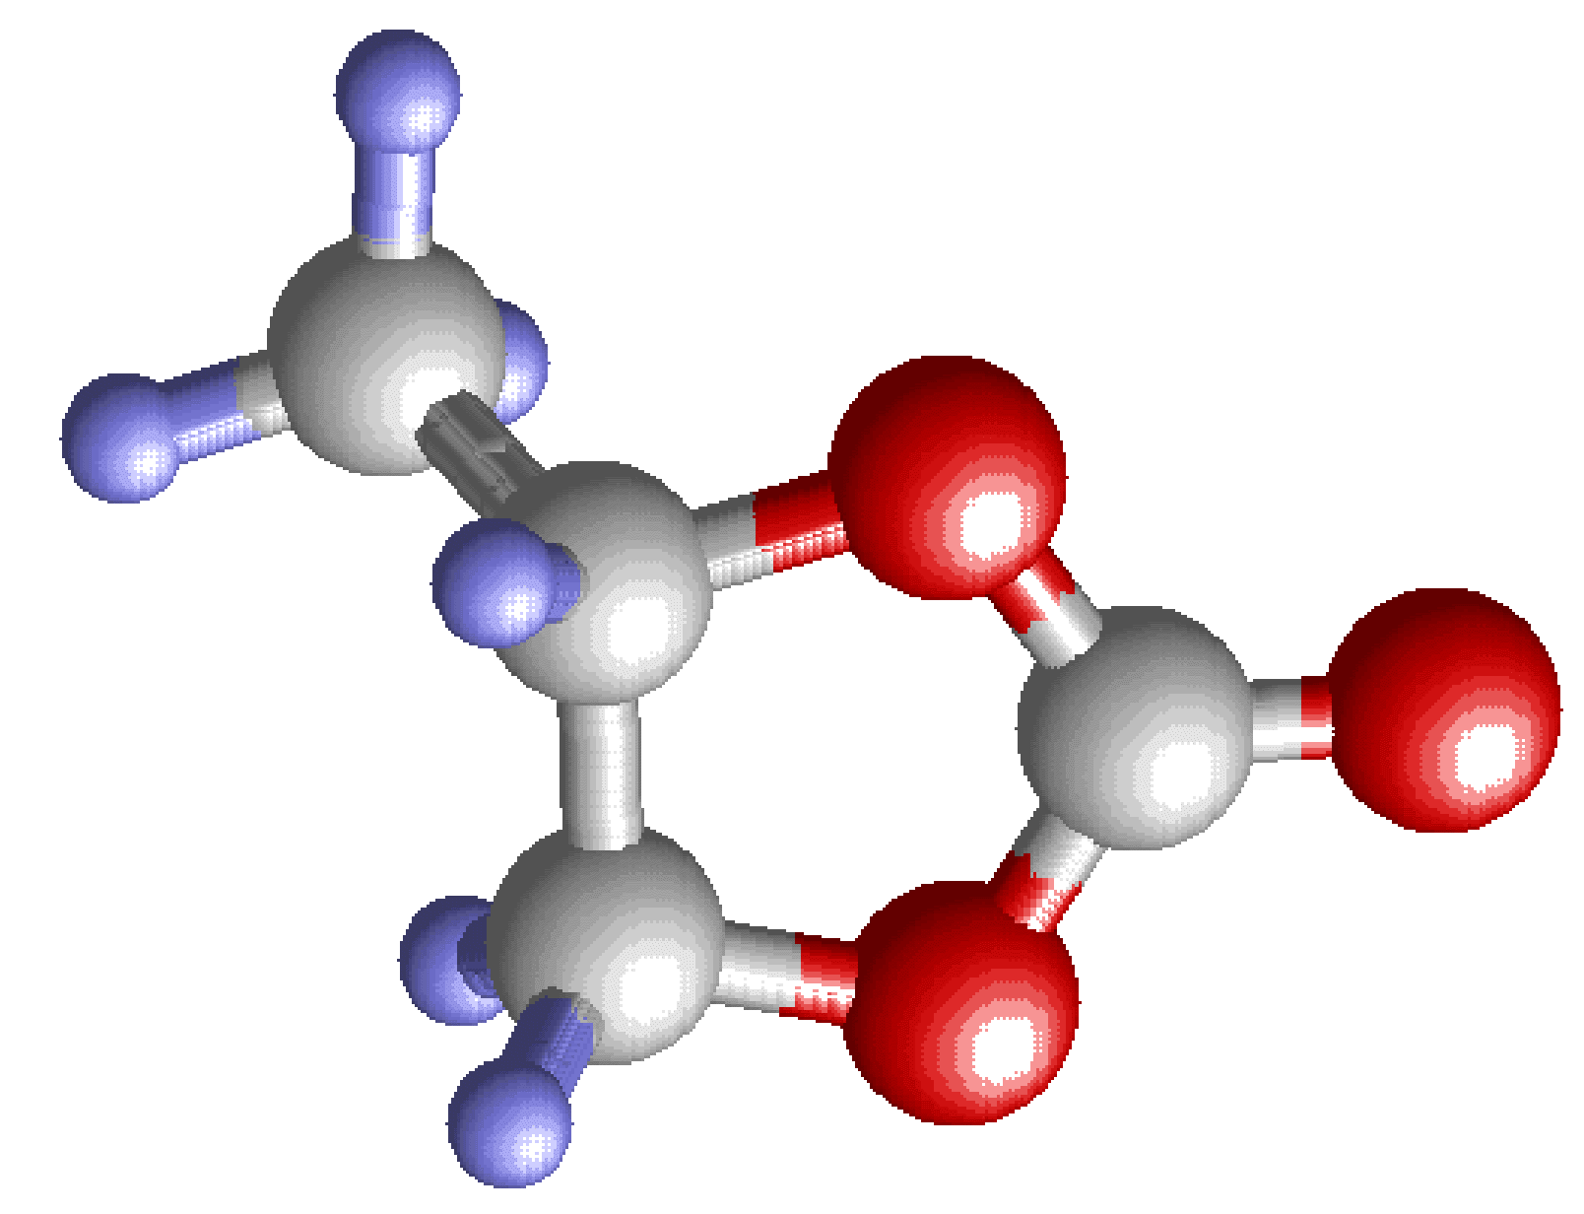
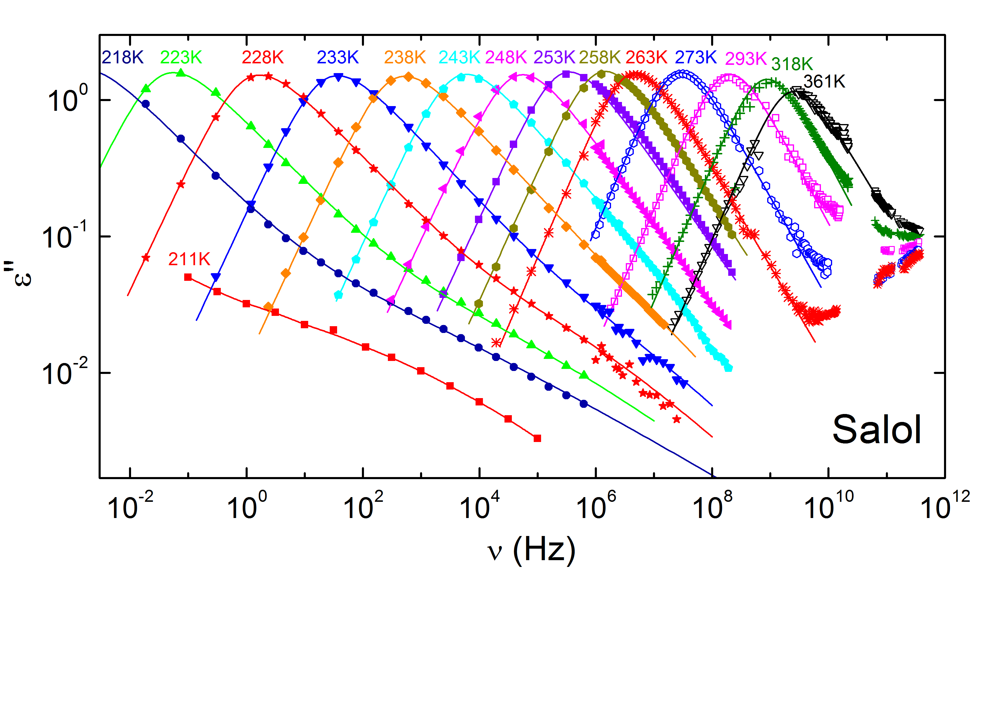
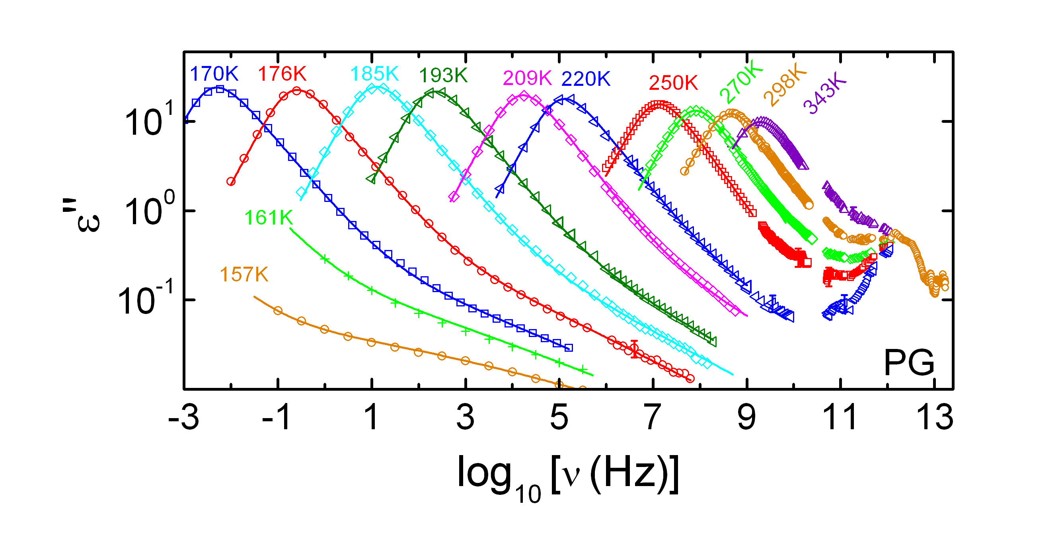
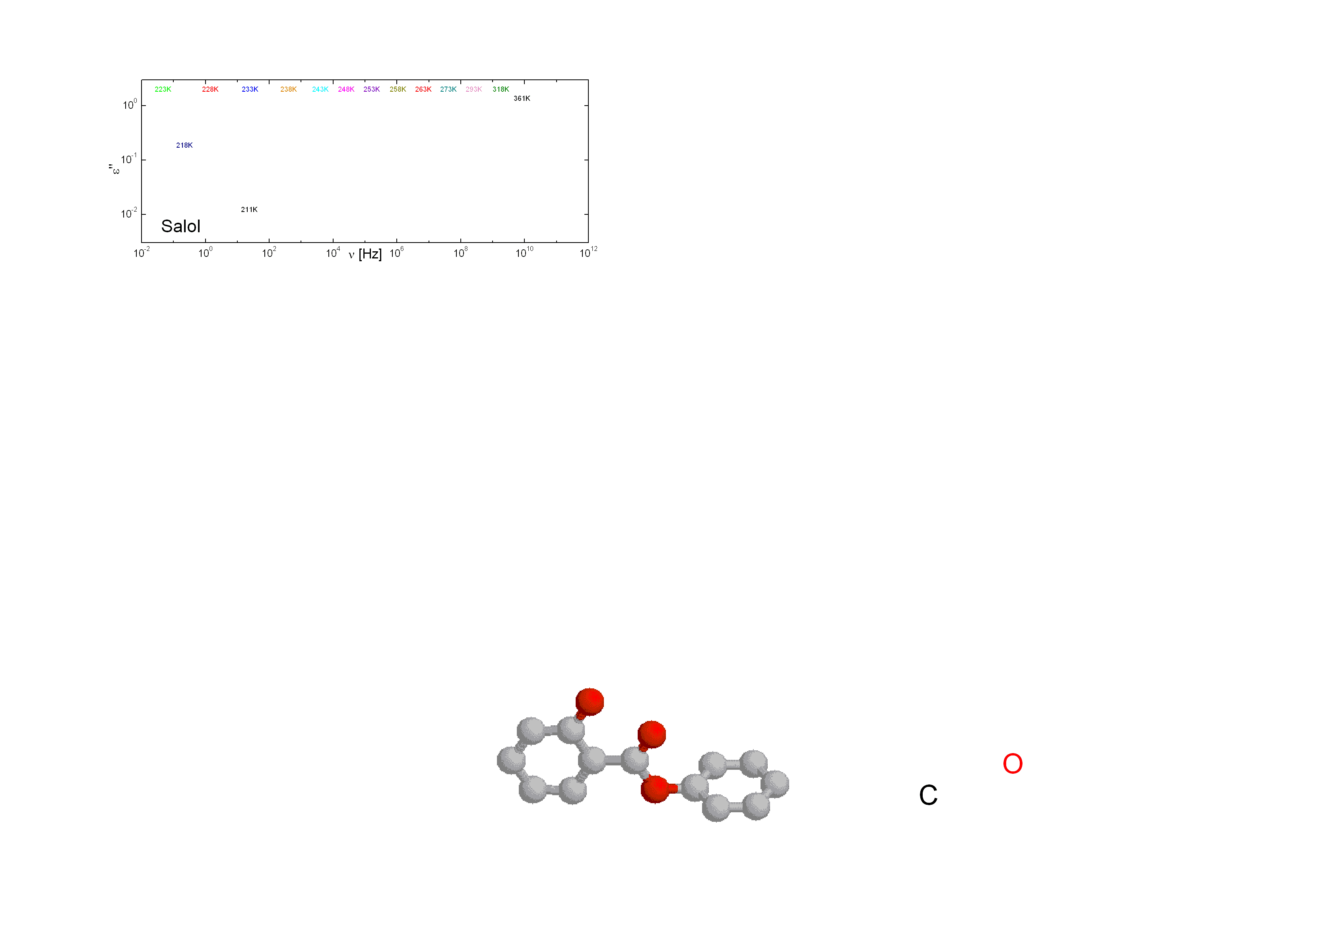
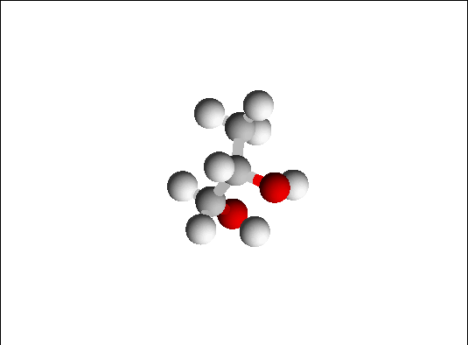
Broadband Dielectric Spectra of Glassformers
P. Lunkenheimer et al., PRL 77, 318 (1996); P. Lunkenheimer and A. Loidl, Chem. Phys. 284, 205 (2002); P. Lunkenheimer et al., PRL 95, 055702 (2005)
U. Schneider et al., Phys. Rev. E 59, 6924 (1999)
M. Köhler, P. Lunkenheimer, and A. Loidl, unpublished; M. Köhler, PhD thesis (2010)
M. Köhler et al., JNCS 356, 529 (2010); M. Köhler, PhD thesis (2010)

Slide 6
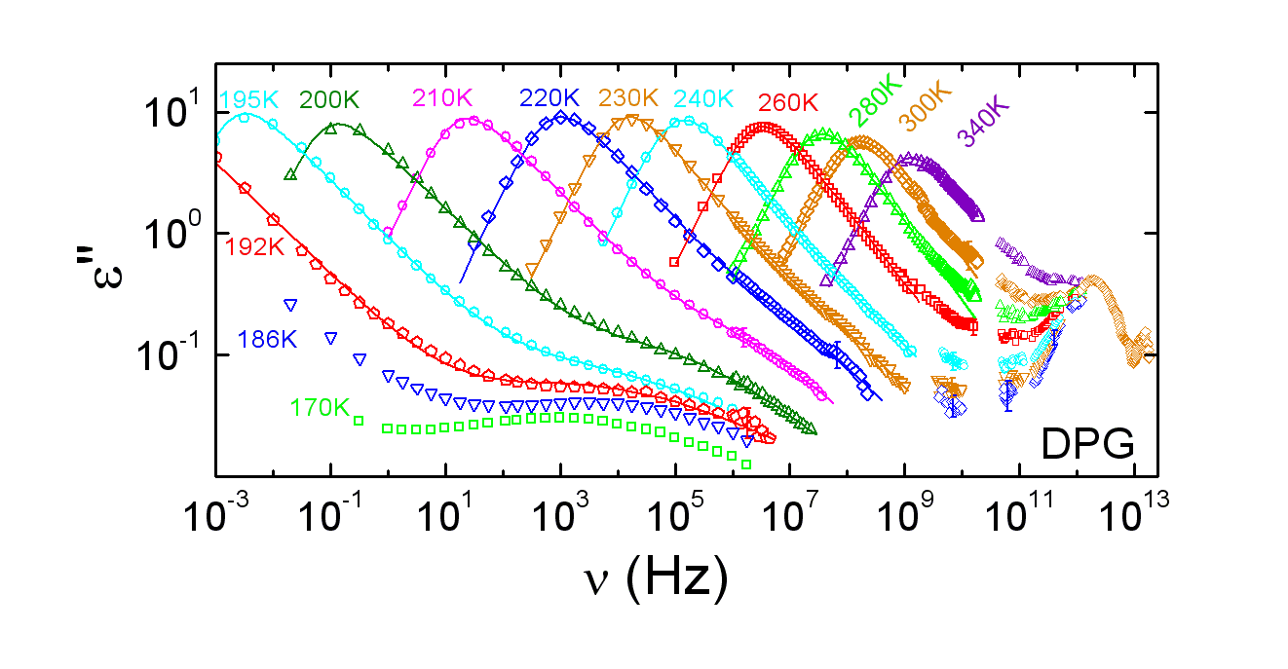
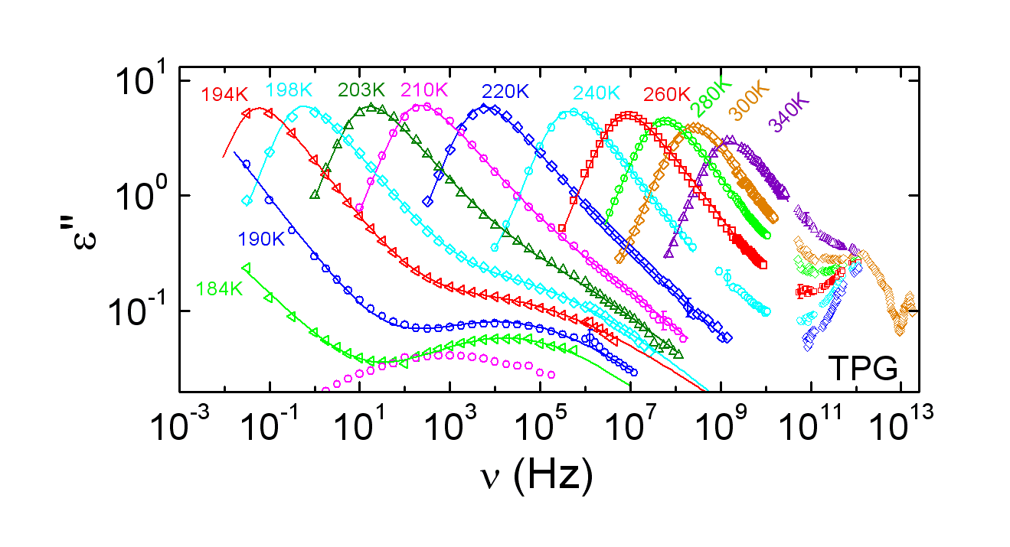
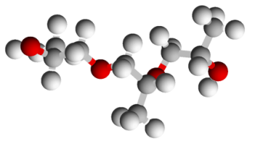
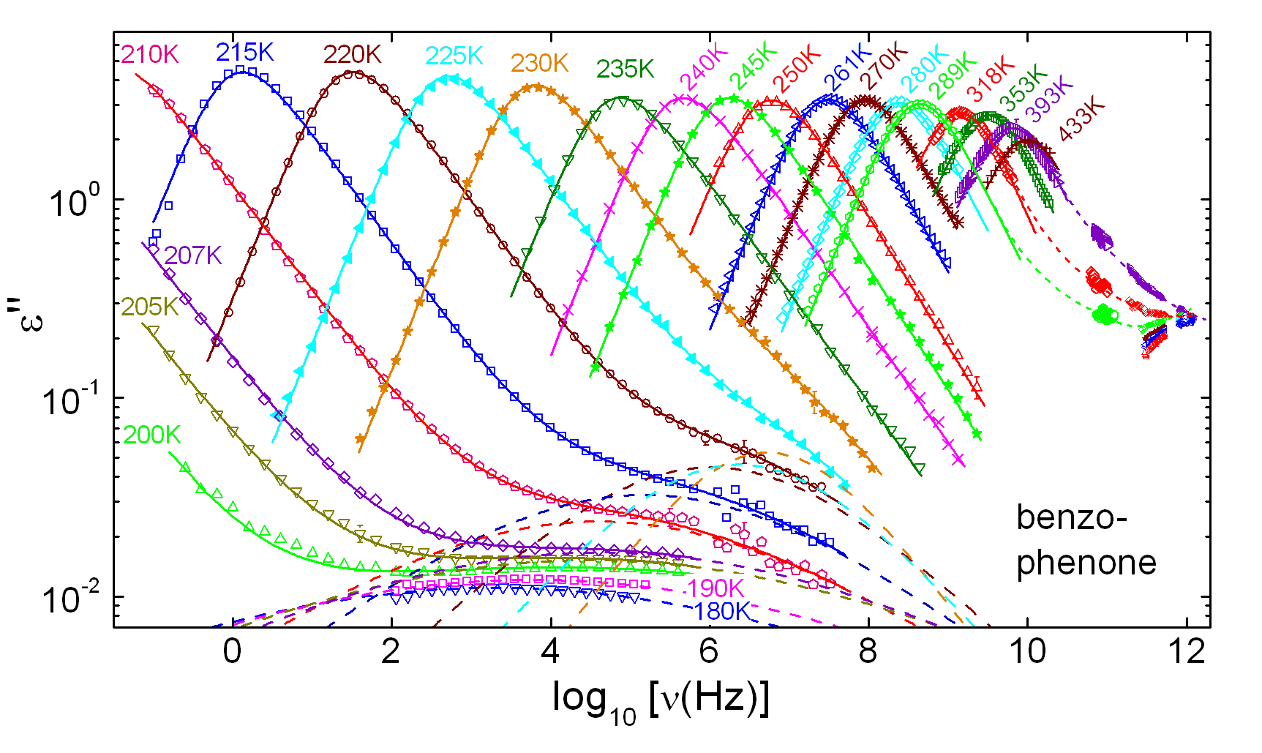
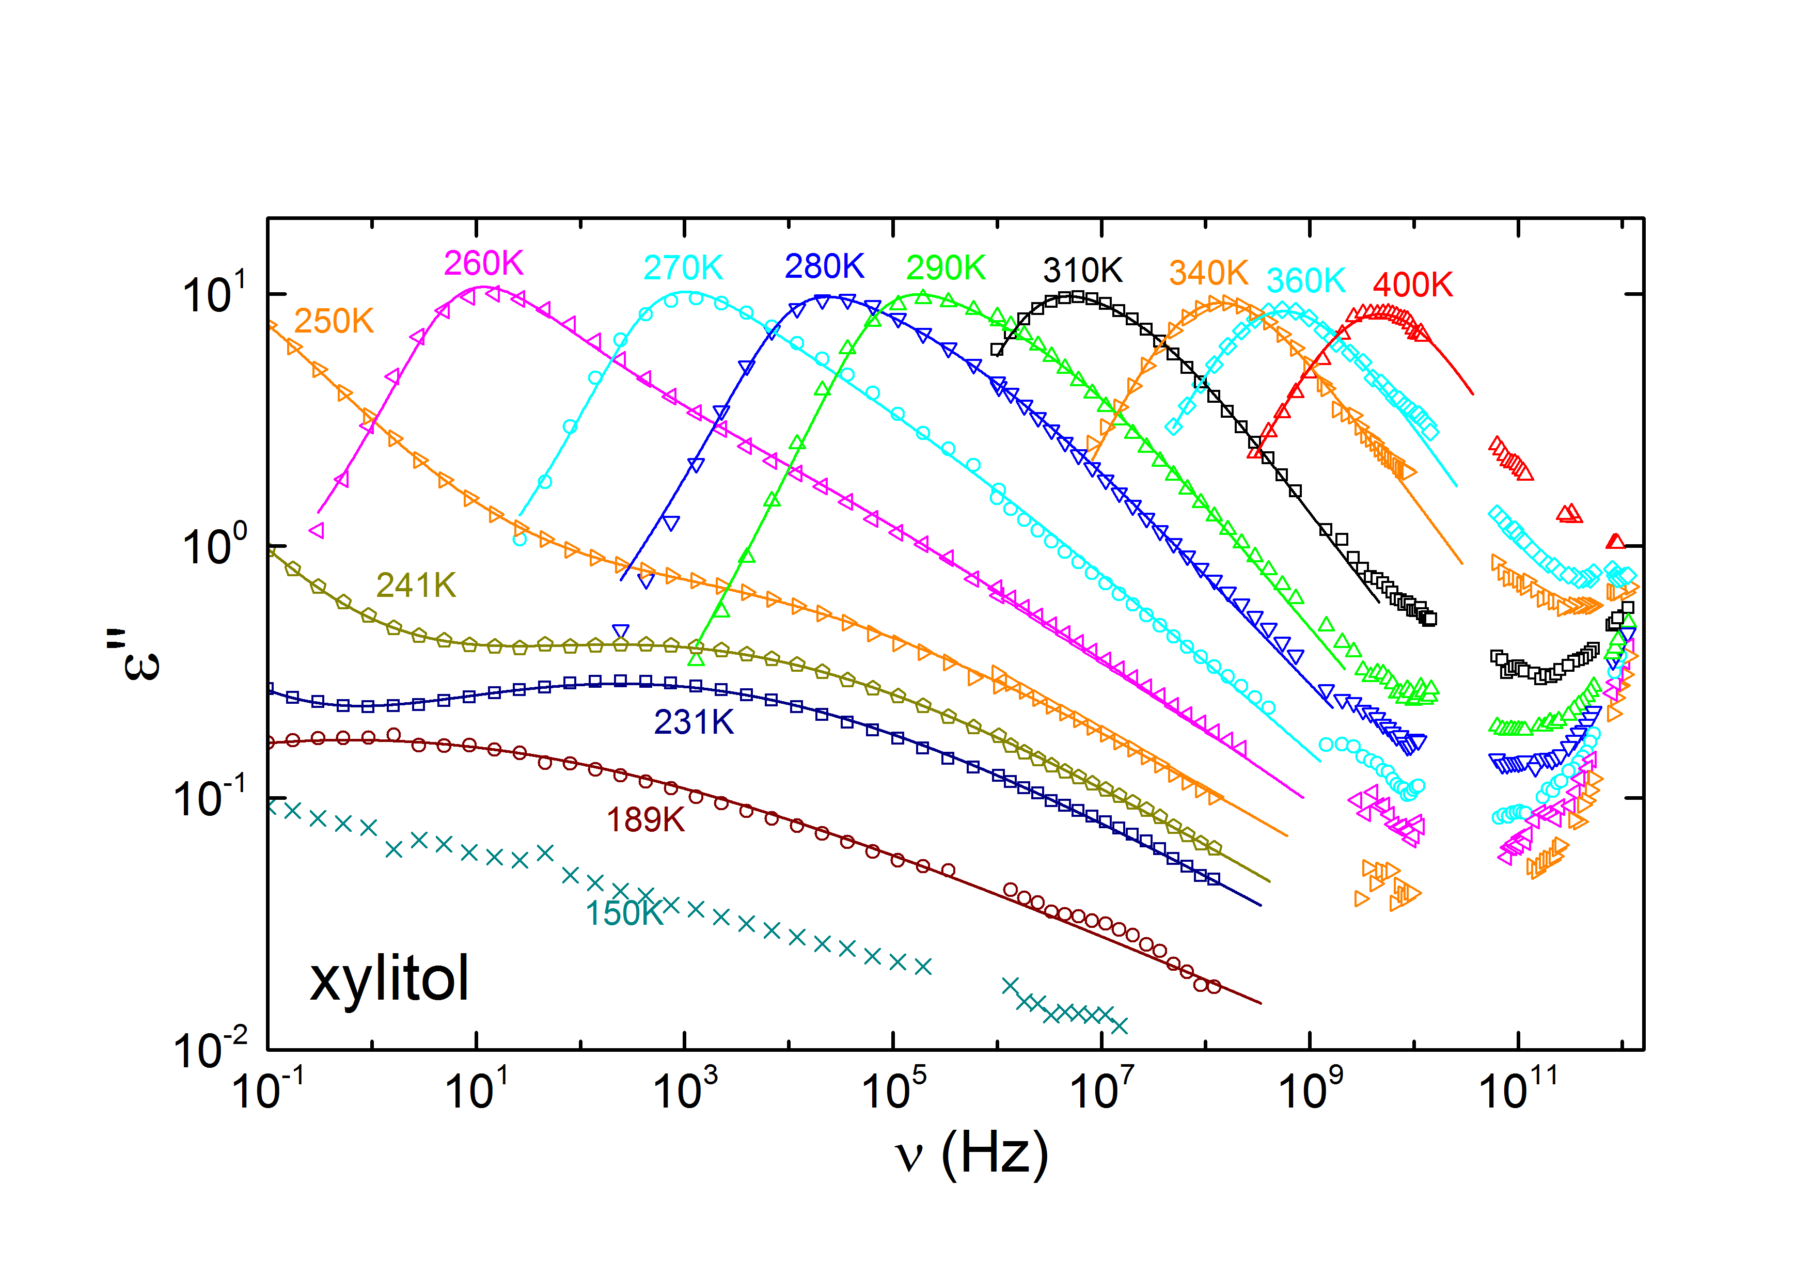
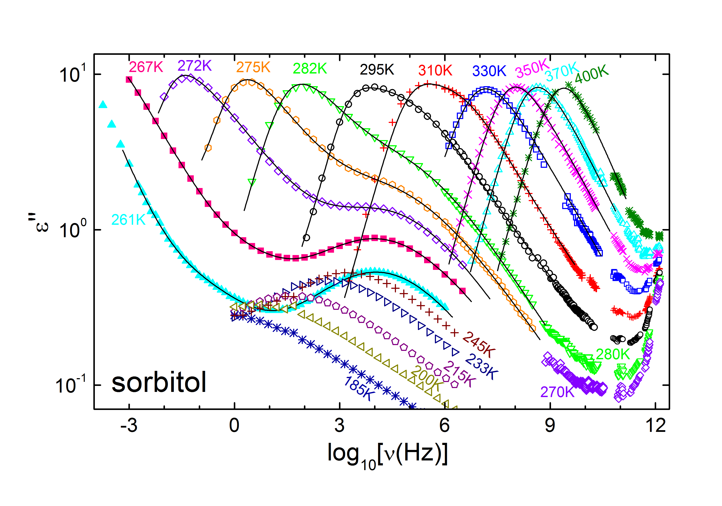
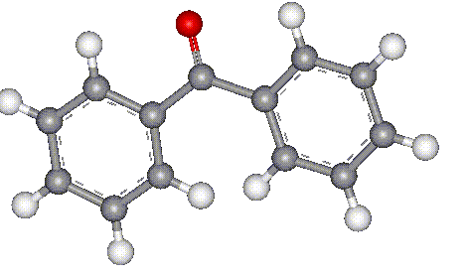
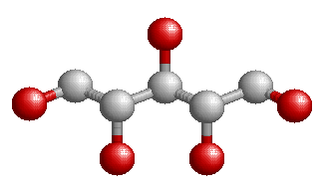
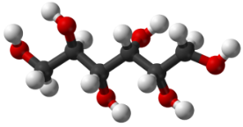
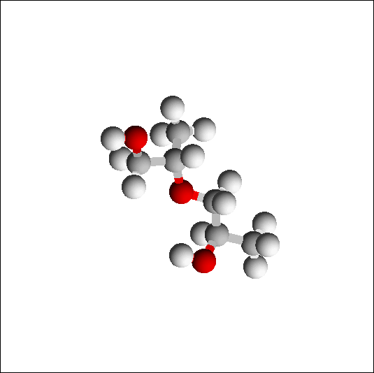
Broadband Dielectric Spectra of Glassformers
M. Köhler et al., JNCS 356, 529 (2010); M. Köhler, PhD thesis (2010)
M. Köhler et al., JNCS 356, 529 (2010); M. Köhler, PhD thesis (2010)
P. Lunkenheimer et al., PRE 77, 031506 (2008); M. Köhler, PhD thesis (2010)
S. Kastner et al., JNCS 357, 510 (2011)
S. Kastner et al., JNCS 357, 510 (2011)

Slide 7

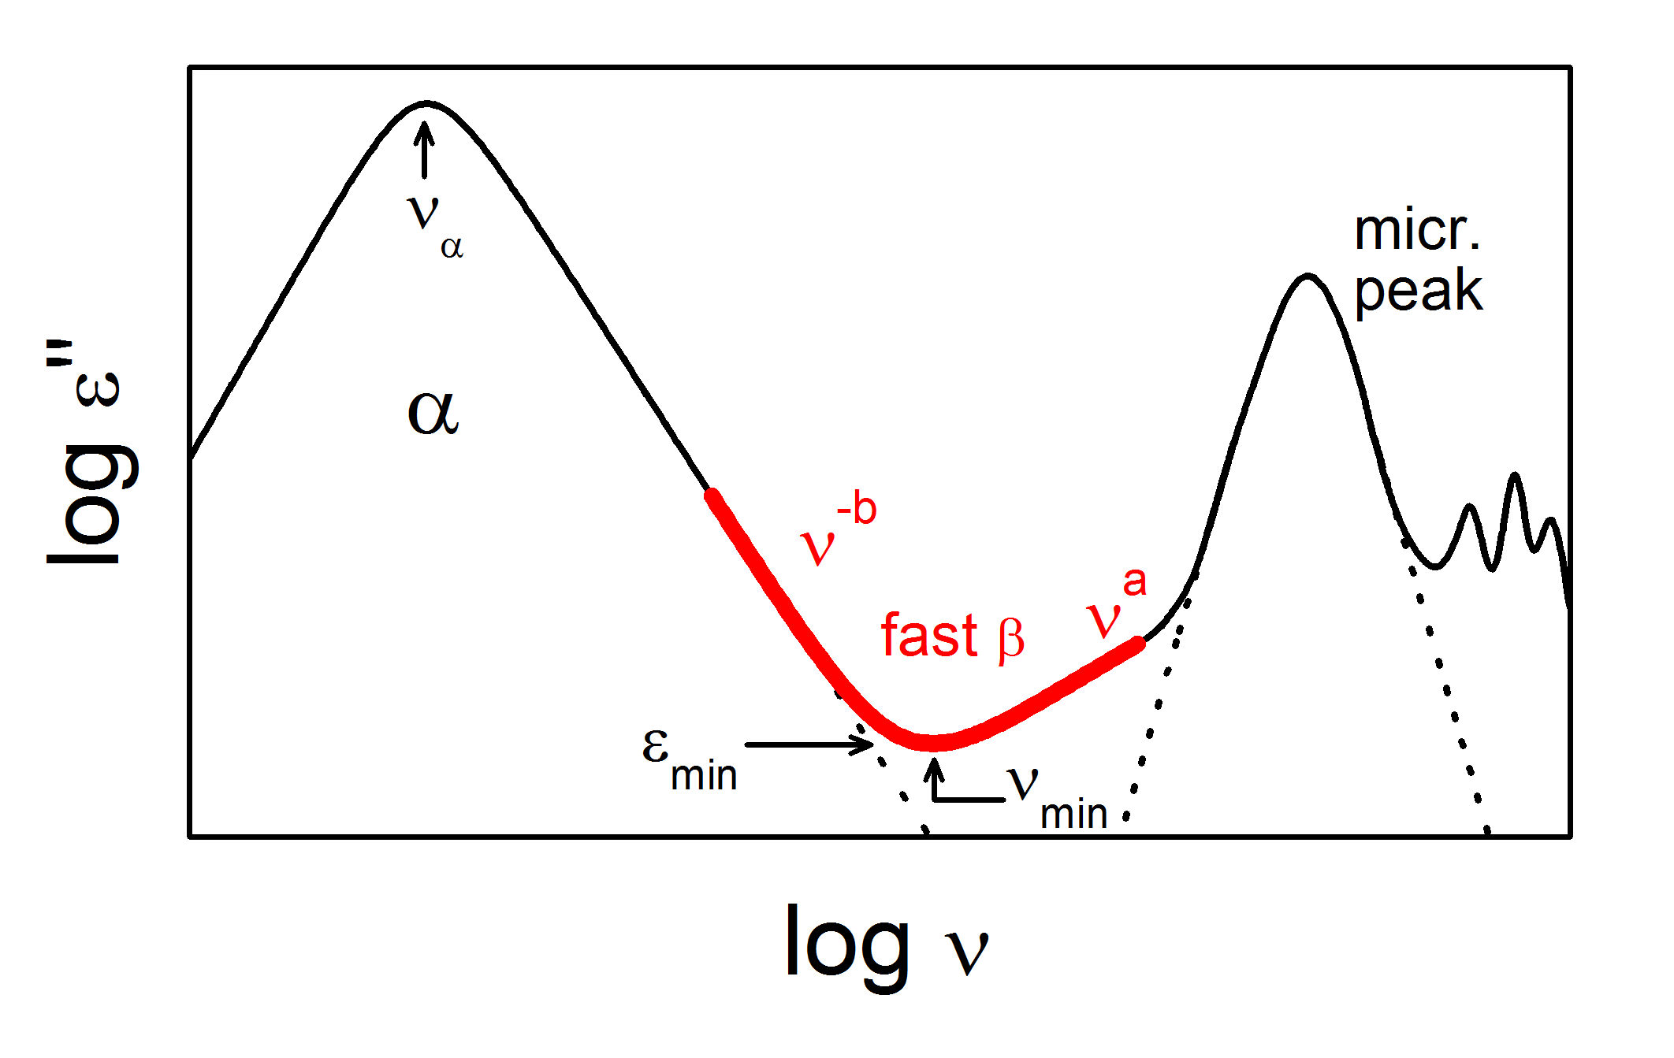
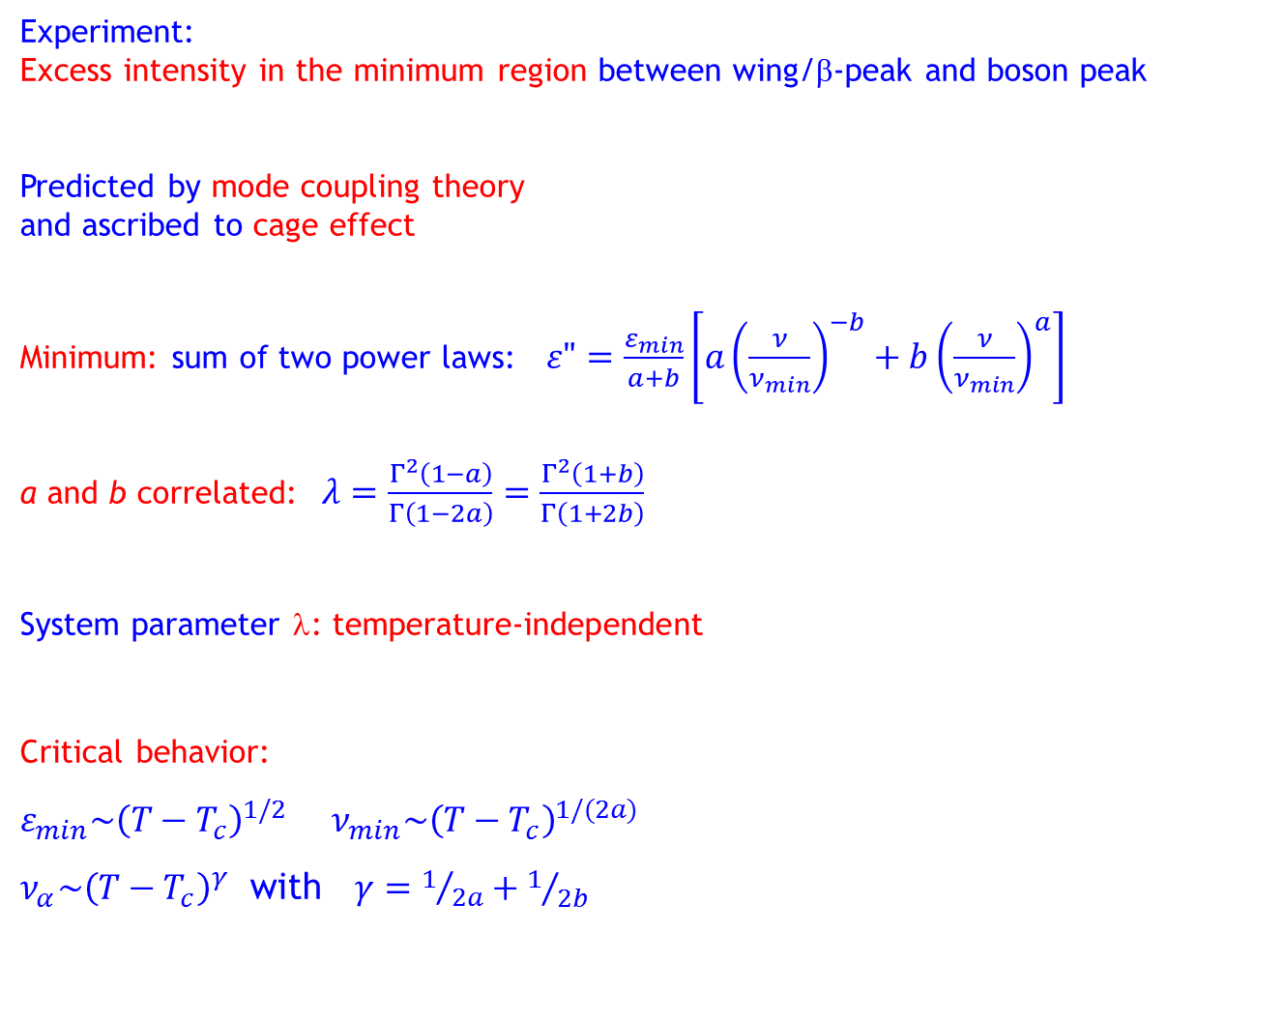
The Fast Process in Idealized MCT
Experiment:
Excess intensity in the minimum region between wing/β-peak and boson peak
Predicted by mode coupling theory
and ascribed to cage effect
Minimum: sum of two power laws: $ε"=\frac{ε_{min}}{a+b}\left[a{\left(\frac{ν}{ν_{min}}\right)}^{−b}+b{\left(\frac{ν}{ν_{min}}\right)}^{a}\right]$
a and b correlated:$λ=\frac{Γ^{2}\left(1−a\right)}{Γ\left(1−2a\right)}=\frac{Γ^{2}\left(1+b\right)}{Γ\left(1+2b\right)}$
System parameter λ: temperature-independent
Critical behavior:
$ε_{min}\sim {\left(T−T_{c}\right)}^{1/2}$ $ν_{min}\sim {\left(T−T_{c}\right)}^{1/(2a)}$
$ν_{α}\sim {\left(T−T_{c}\right)}^{γ}$ with $γ=1/{2a}+1/{2b}$
U. Bengtzelius, W. Götze, and A. Sjölander, J. Phys. C 17, 5915 (1984); E. Leutheuser, Phys. Rev. A 29, 2765 (1984); W. Götze, Z. Phys. B 60, 195 (1985); W. Götze and L. Sjögren, Rep. Progr. Phys. 55, 241 (1992)

Slide 8
The Fast Process: A New Scenario
W. Götze, M. Sperl: Fast process leads to Cole-Cole-peak
W. Götze and M. Sperl, Phys. Rev. Lett. 92, 105701 (2004); M. Sperl, Phys. Rev. E 74, 011503 (2006)
Conventional scenario: Peak at high ν → minimum
New scenario: Peak at low ν → excess wing!
L.C. Pardo, P. Lunkenheimer, and A. Loidl, PRE 76, 030502(R) (2007)

Slide 9
The Fast Process in Dielectric Spectroscopy
Minimum in dielectric loss
Excess intensity in minimum region (no trivial superposition!)
MCT fits work over 2-3 frequency decades
[Ca(NO₃)₂]_{0.4}[KNO₃]_{0.6} (CKN)
P. Lunkenheimer et al., PRL 77, 318 (1996); P. Lunkenheimer et al., PRL 78, 2995 (1997); U. Schneider et al., Phys. Rev. E 59, 6924 (1999)

Slide 10
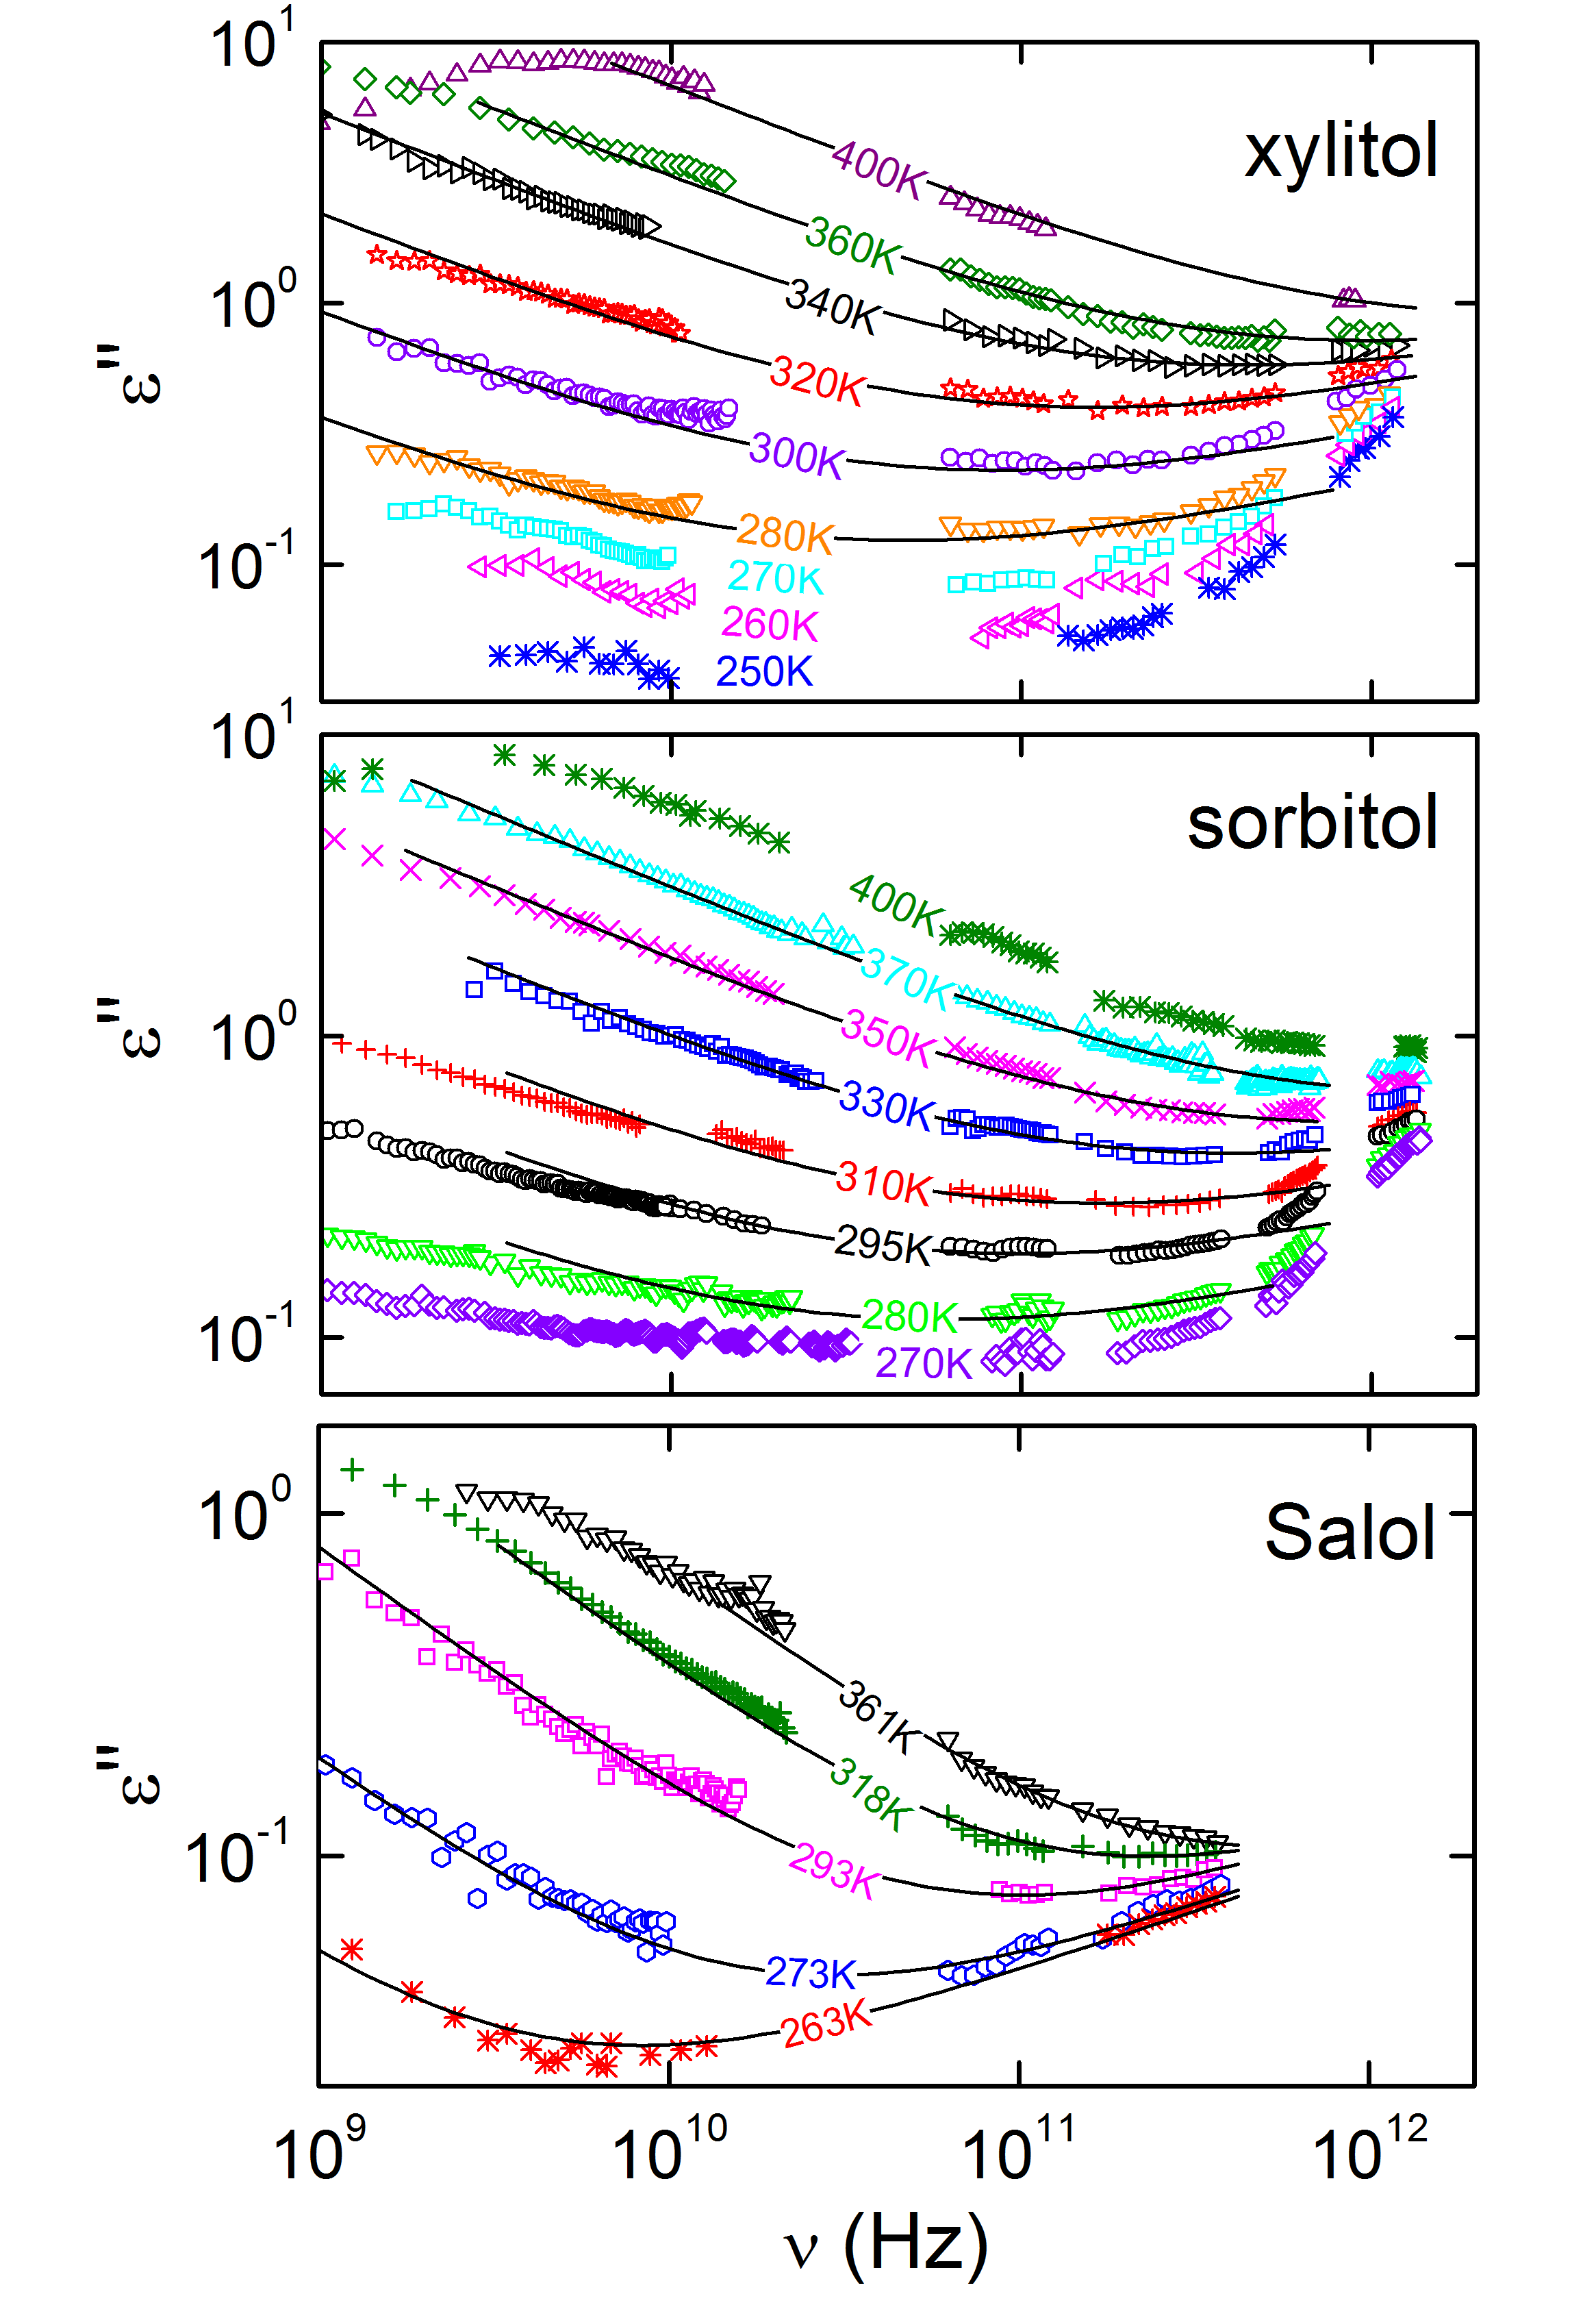
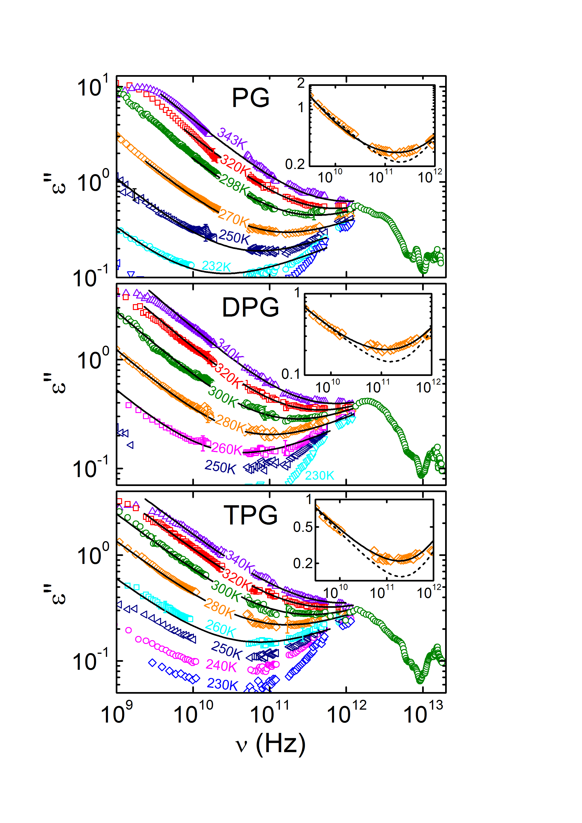
The Fast Process in Dielectric Spectroscopy: Recent Results
M. Köhler et al., JNCS 356, 529 (2010); S. Kastner et al., JNCS 357, 510 (2011); M. Köhler, PhD thesis (2010)

Slide 11
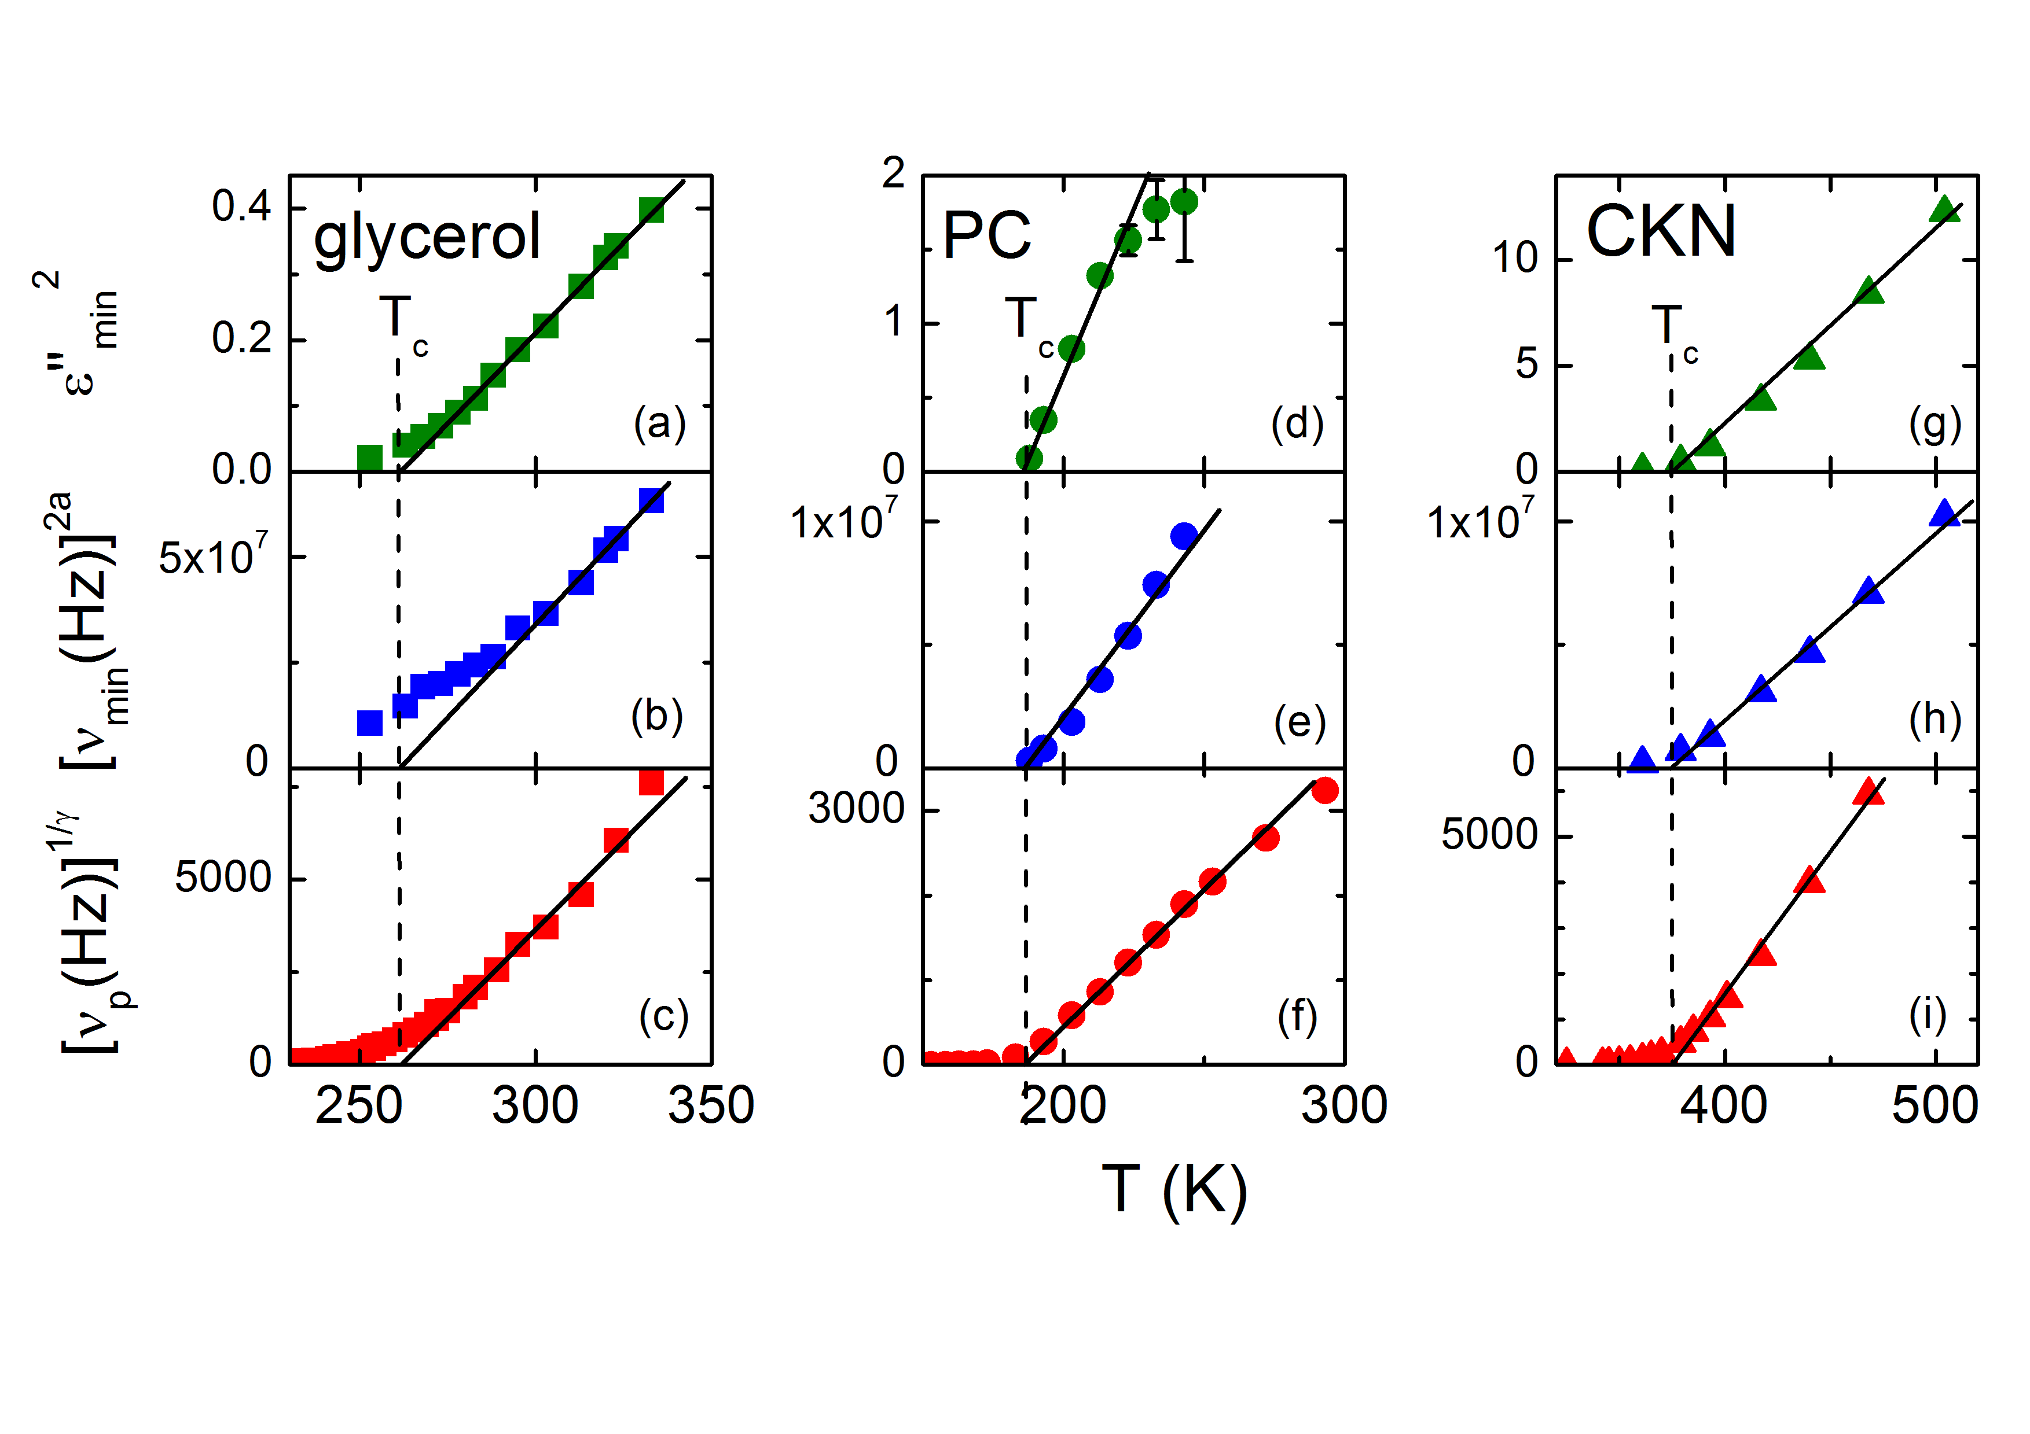
The Fast Process: Critical Laws
P. Lunkenheimer et al., PRL 77, 318 (1996); P. Lunkenheimer et al., PRL 78, 2995 (1997); U. Schneider et al., Phys. Rev. E 59, 6924 (1999)
$ε_{min}\sim {\left(T−T_{c}\right)}^{1/2}$ $ν_{min}\sim {\left(T−T_{c}\right)}^{1/\left(2a\right)} {ν_{p}=ν}_{α}\sim {\left(T−T_{c}\right)}^{γ}$

Slide 12
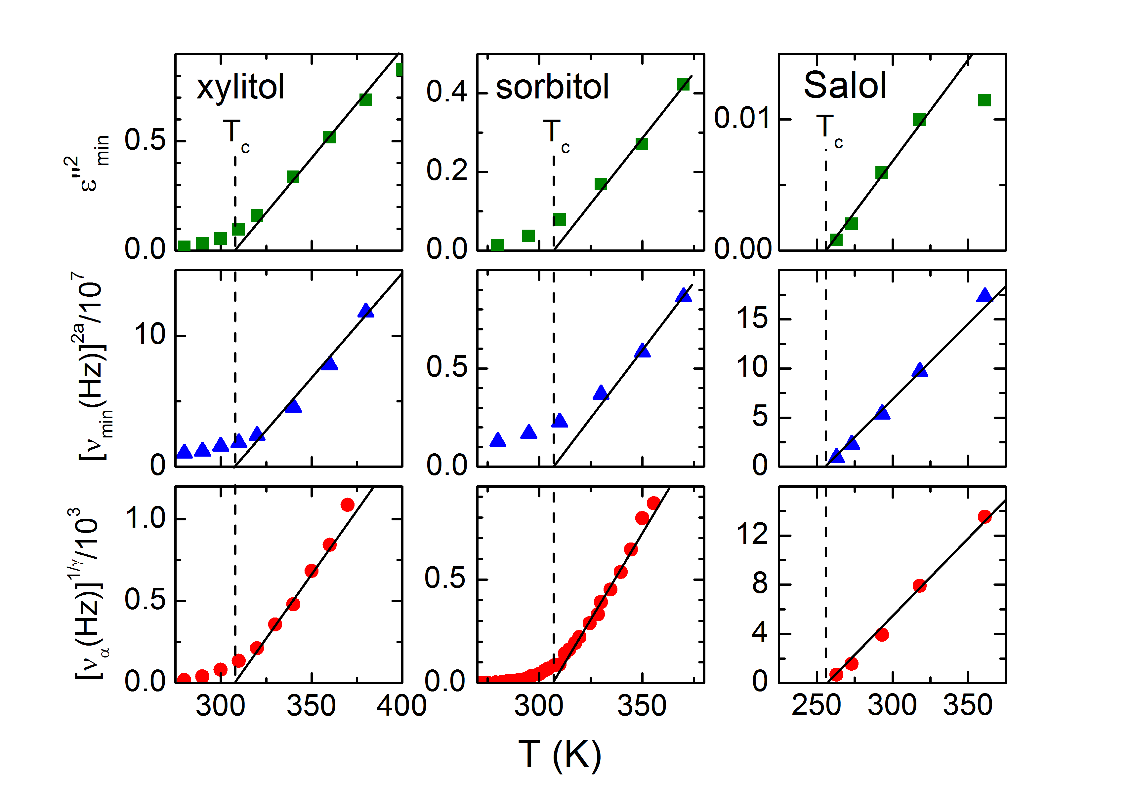
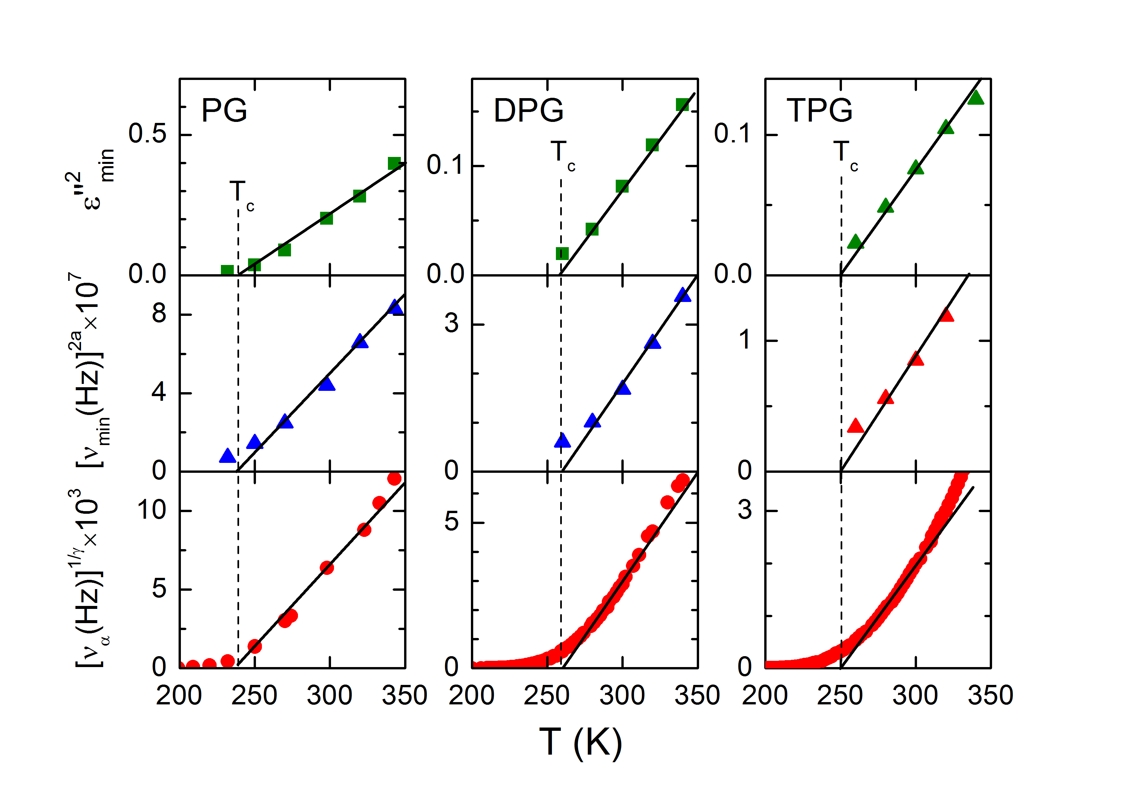
The Fast Process: Critical Laws
M. Köhler et al., JNCS 356, 529 (2010); S. Kastner et al., JNCS 357, 510 (2011); M. Köhler, PhD thesis (2010)
$ε_{min}\sim {\left(T−T_{c}\right)}^{1/2}$ $ν_{min}\sim {\left(T−T_{c}\right)}^{1/\left(2a\right)} {ν_{p}=ν}_{α}\sim {\left(T−T_{c}\right)}^{γ}$

Slide 13
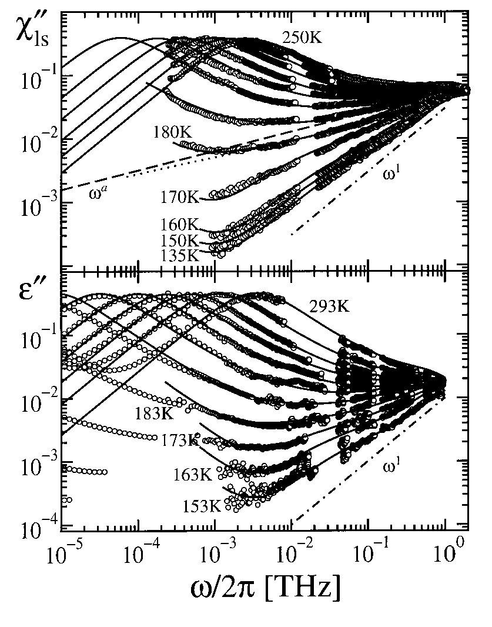
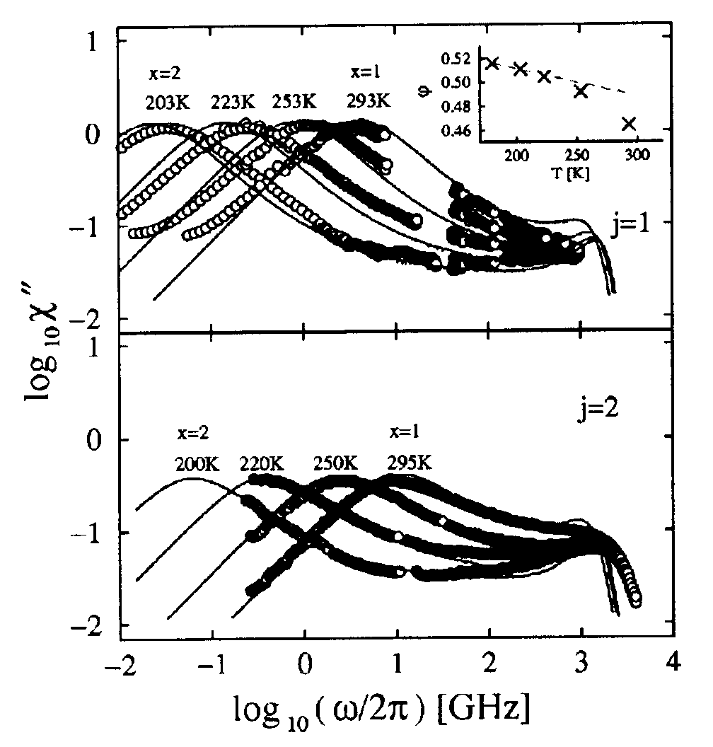
The Fast Process
More sophisticated analyses within mode coupling theory:
"Two-component schematic" mode-coupling model:
Dumbbell molecule in hard-sphere liquid:
propylene carbonate
propylene carbonate
light
scattering
dielectric spectroscopy
diel. spectr.
light scattering
W. Götze and Th. Voigtmann, PRE 61, 4133 (2000)
W. Götze, A.P. Singh, and Th. Voigtmann, PRE 61, 6934 (2000)

Slide 14
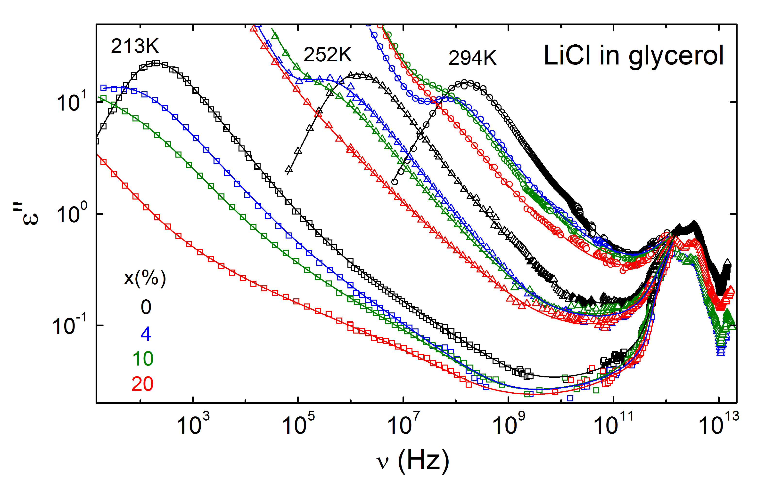
LiCl in Glycerol: Broadband Spectra
M. Köhler, P. Lunkenheimer, and A. Loidl, Eur. Phys. J. E 27, 115 (2008); M. Köhler, P. Lunkenheimer, Y. Goncharov, and A. Loidl, unpublished; M. Köhler, PhD thesis (2010)

Slide 15
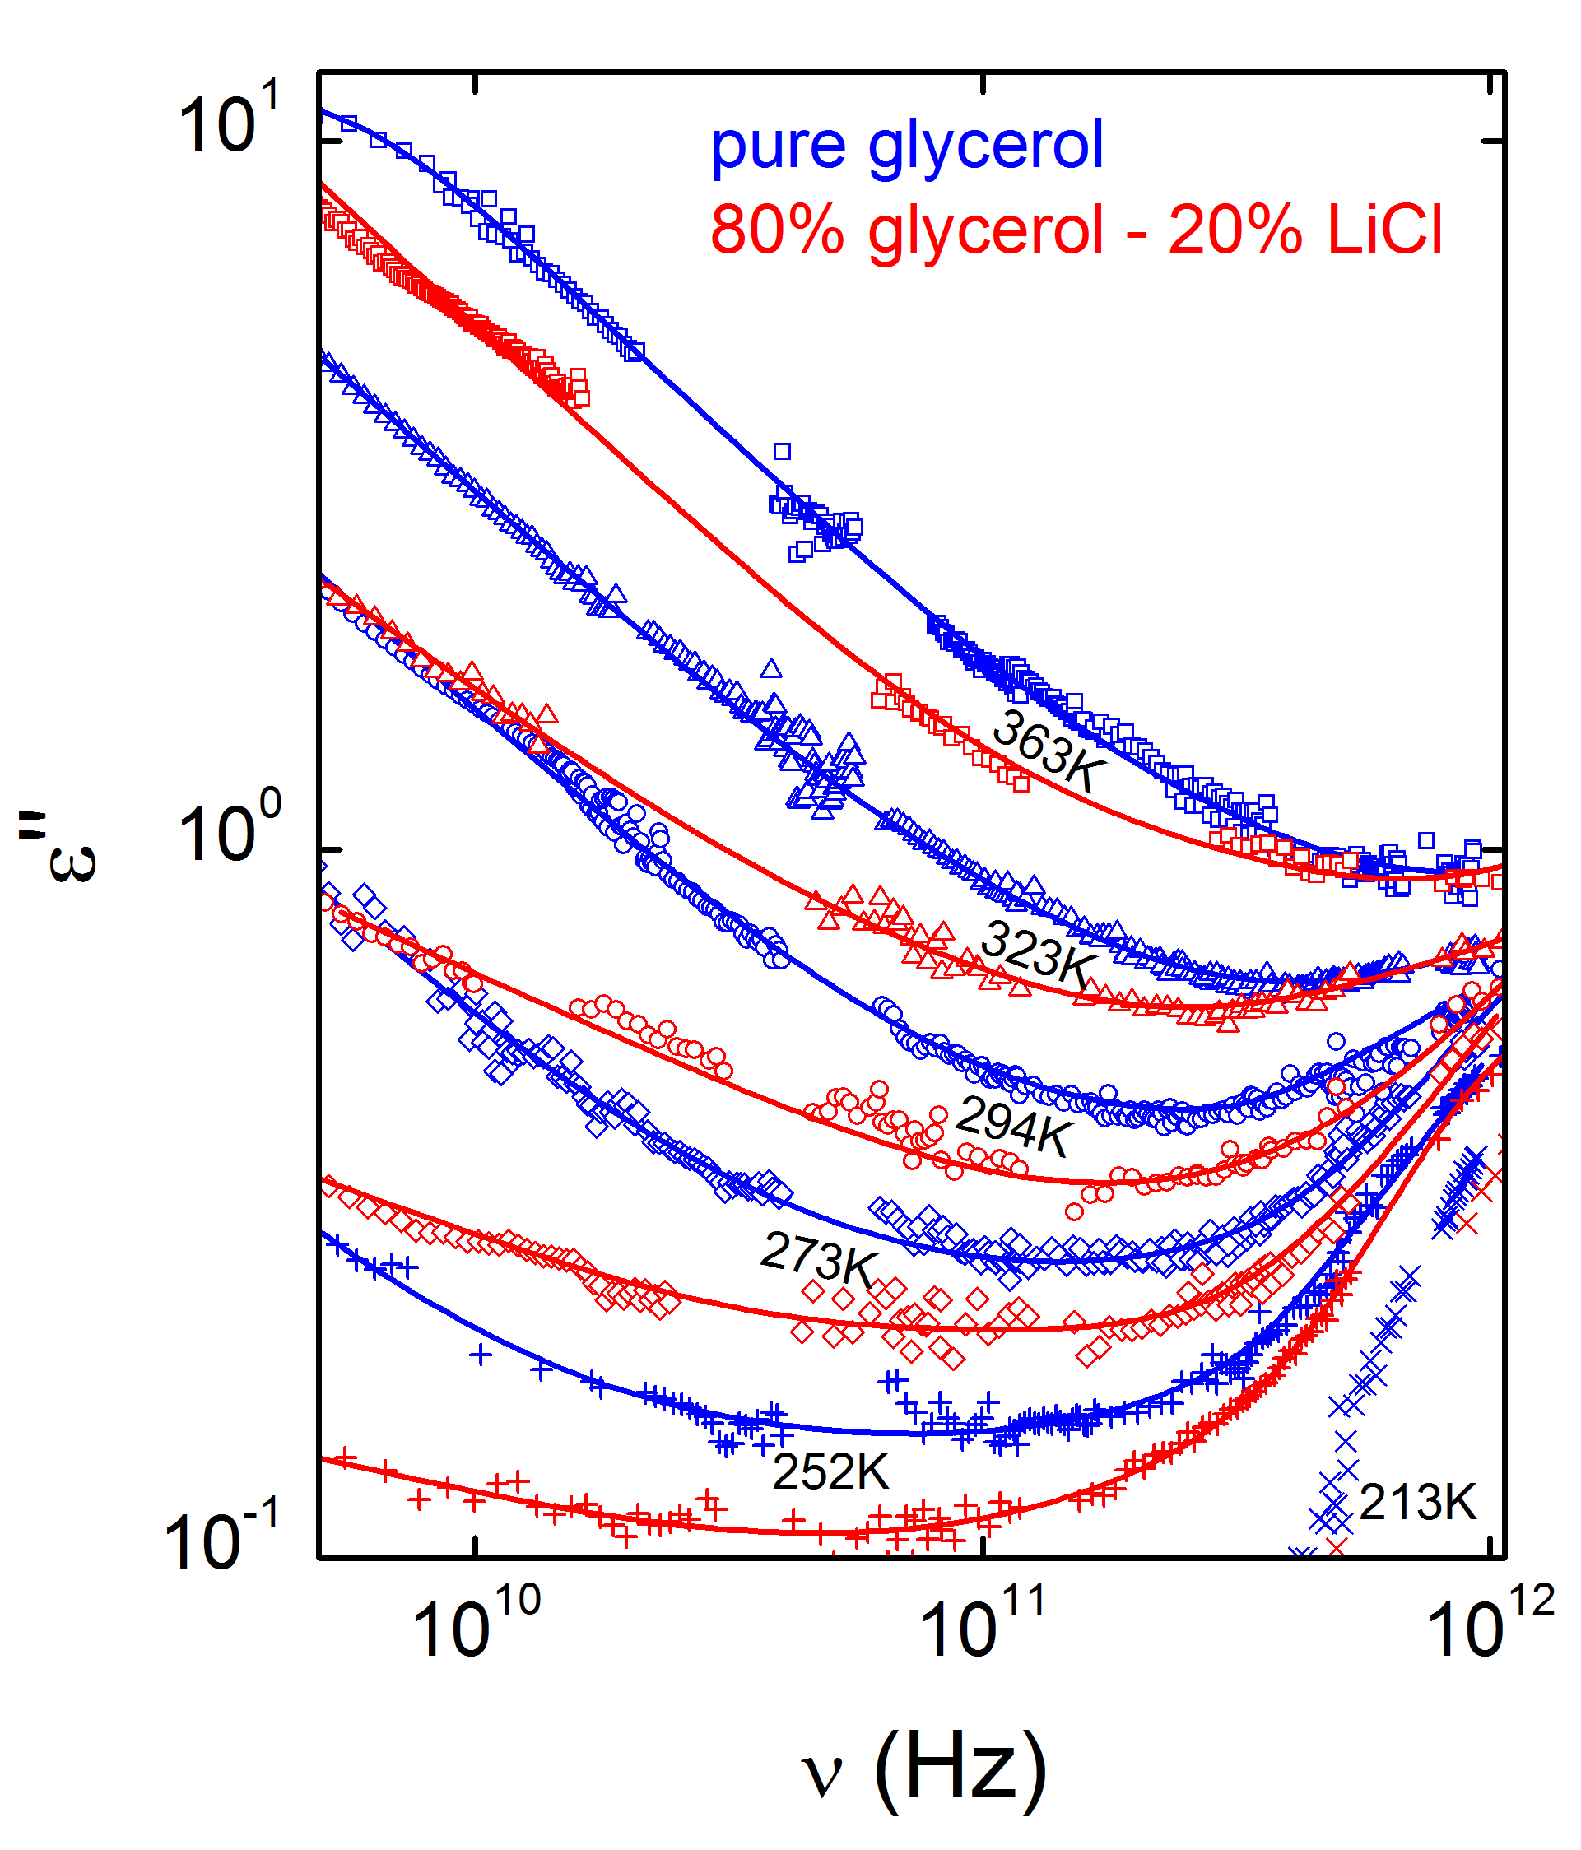
LiCl in Glycerol: Fast Process
LiCl addition → minimum broadens
M. Köhler, P. Lunkenheimer, Y. Goncharov, and A. Loidl, unpublished; M. Köhler, PhD thesis (2010)

Slide 16
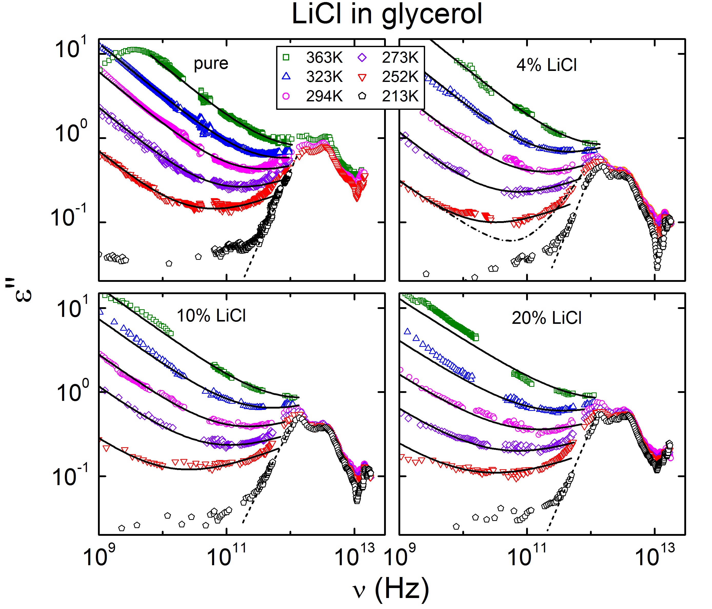
LiCl in Glycerol: Fast Process
Minimum can be well fitted with MCT interpolation formula
LiCl addition → system parameter λ increases
M. Köhler, P. Lunkenheimer, Y. Goncharov, and A. Loidl, unpublished; M. Köhler, PhD thesis (2010)

Slide 17
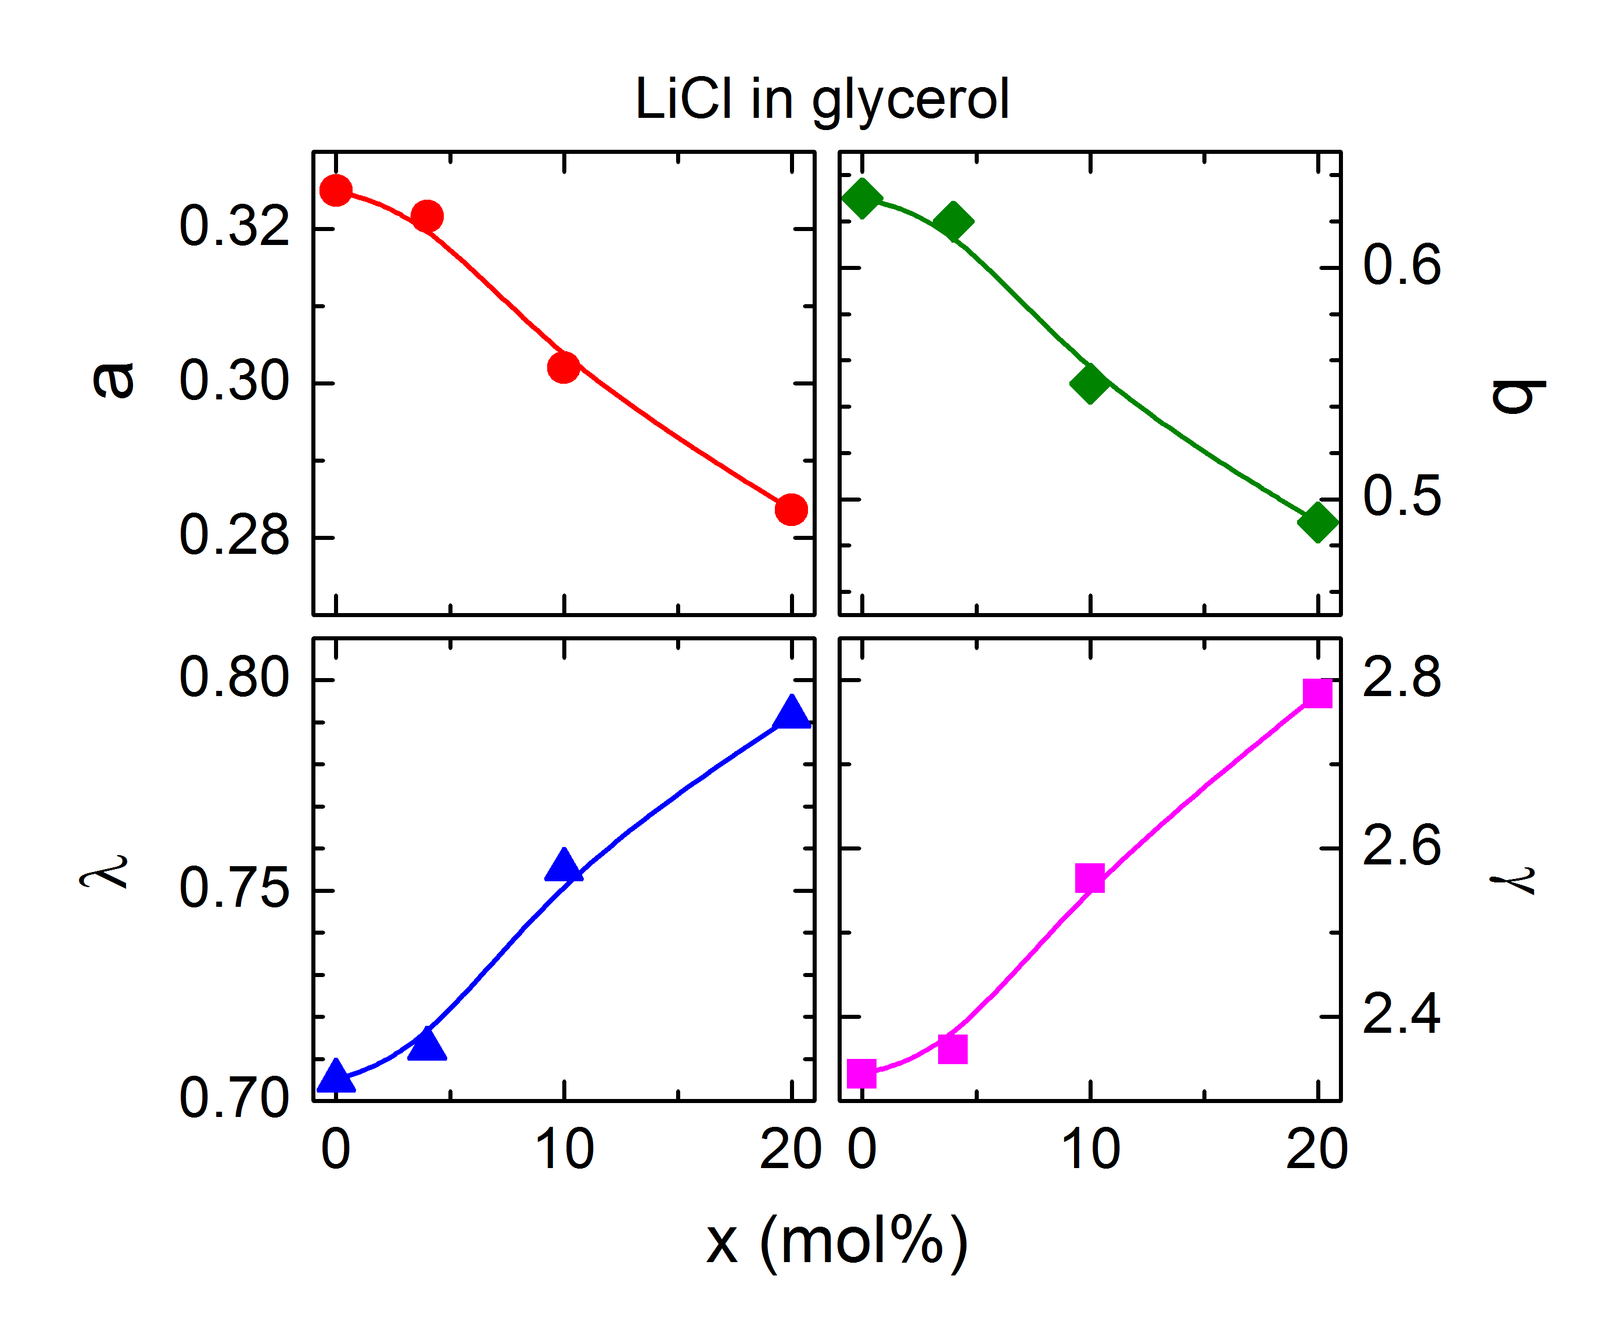
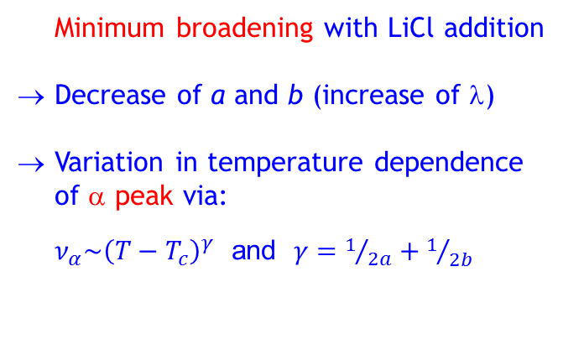
LiCl in Glycerol: Fast Process
MCT parameters
Minimum broadening with LiCl addition
→ Decrease of a and b (increase of λ)
→ Variation in temperature dependence of α peak via:
$ν_{α}\sim {\left(T−T_{c}\right)}^{γ}$ and $γ=1/{2a}+1/{2b}$
M. Köhler, P. Lunkenheimer, Y. Goncharov, and A. Loidl, unpublished; M. Köhler, PhD thesis (2010)

Slide 18
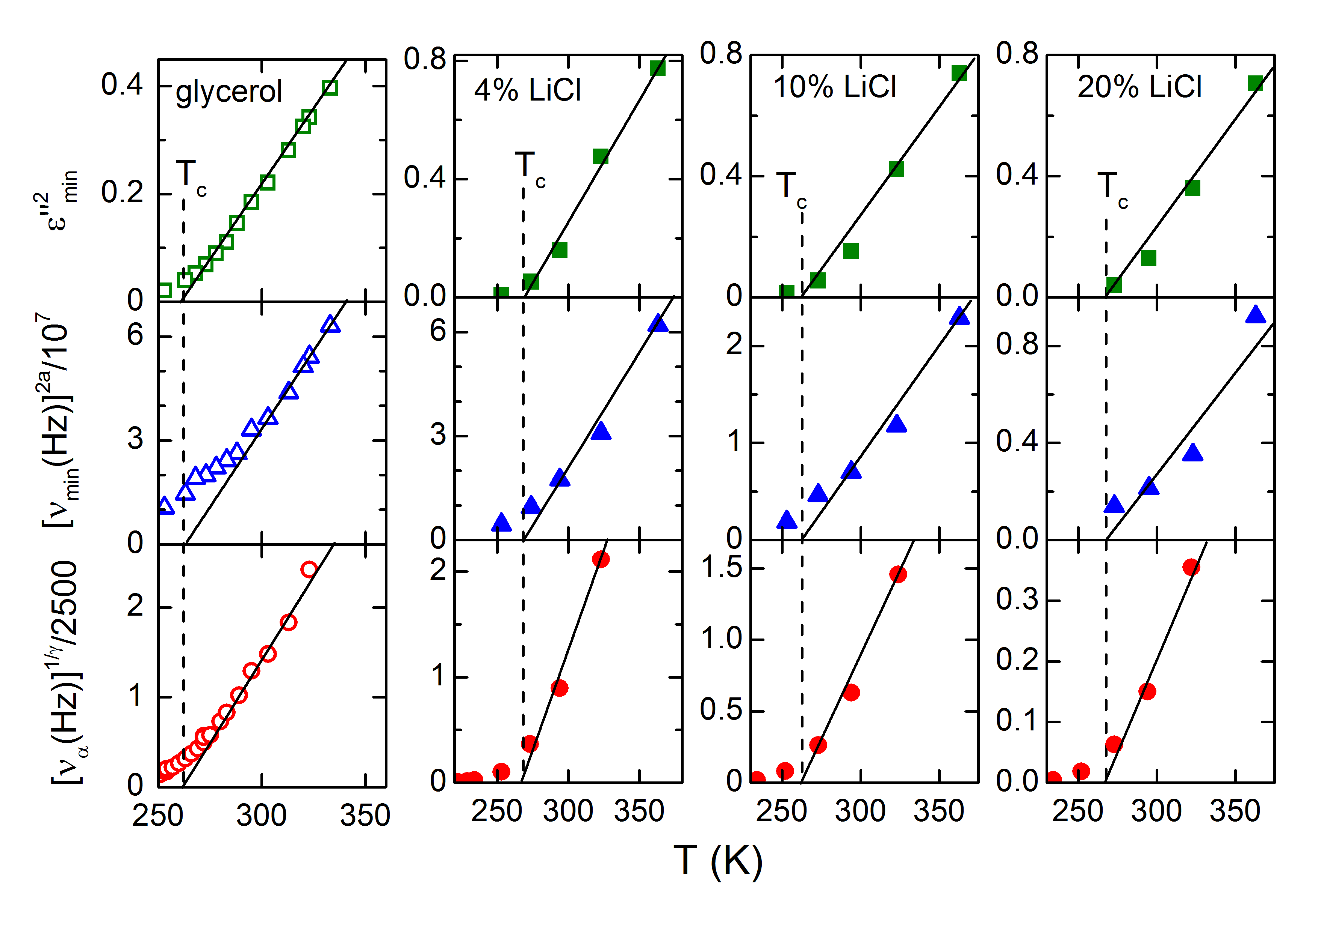
LiCl in Glycerol: Fast Process
Critical laws and determination of T_{c}
$ε_{min}\sim {\left(T−T_{c}\right)}^{1/2}$ $ν_{min}\sim {\left(T−T_{c}\right)}^{1/(2a)} ν_{p}\sim {\left(T−T_{c}\right)}^{γ}$
P. Lunkenheimer et al., PRL 77, 318 (1996); M. Köhler, PhD thesis (2010)

Slide 19
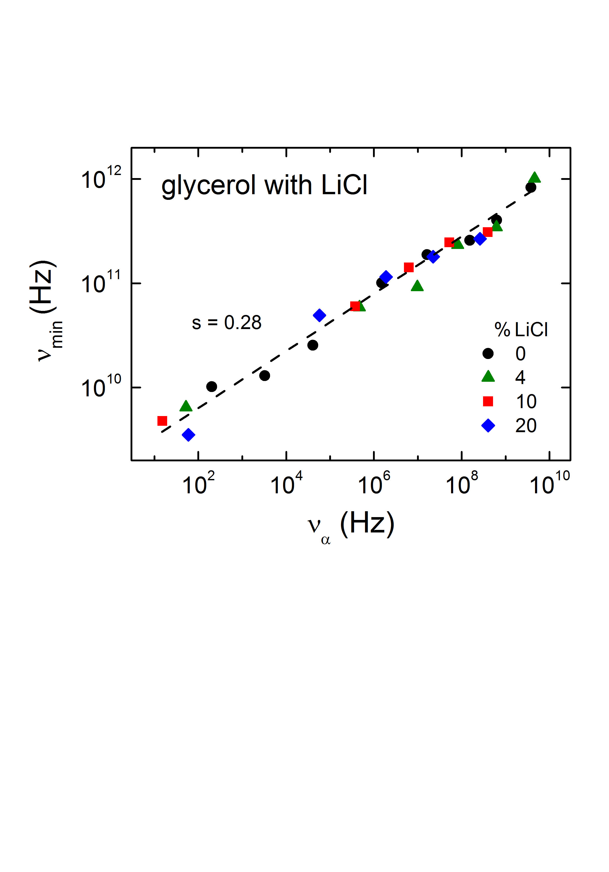
LiCl in Glycerol: Correlation α / fast
M. Köhler et al., unpublished; M. Köhler, PhD thesis (2010)
MCT: $ν_{min}\sim {\left(T−T_{c}\right)}^{1/(2a)} ν_{α}\sim {\left(T−T_{c}\right)}^{γ}$ → $ν_{min}\sim {ν_{α}}^{b/(a+b) }$
mol% LiCl | a | b | b/(a+b)
0% | 0.325 | 0.63 | 0.66
4% | 0.322 | 0.62 | 0.66
10% | 0.302 | 0.55 | 0.65
20% | 0.284 | 0.49 | 0.63
but:
part of the above data are from below T_{c}!

Slide 20
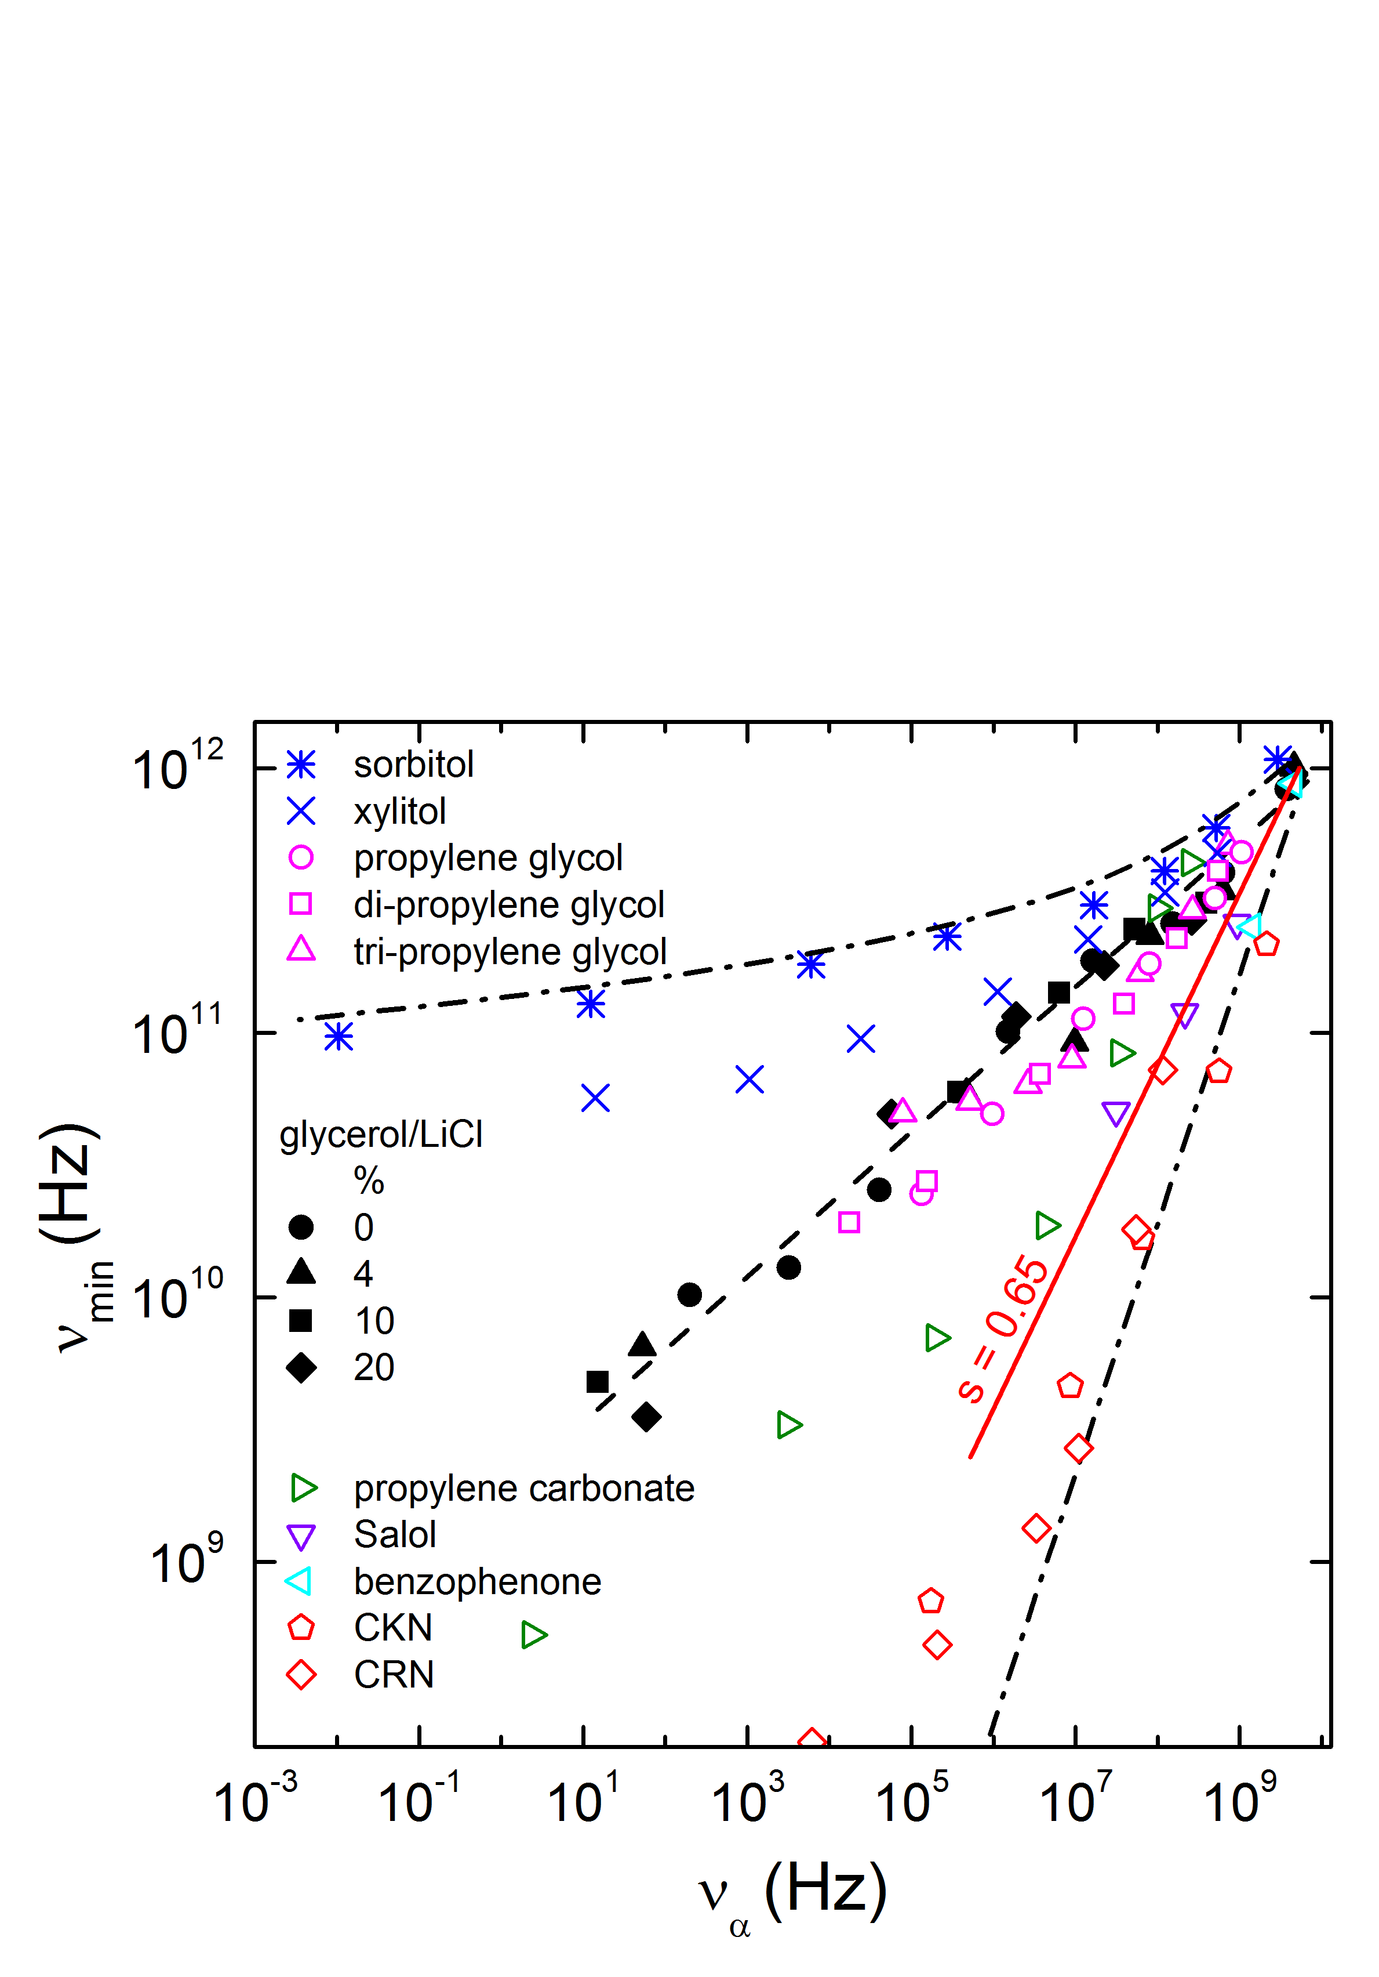
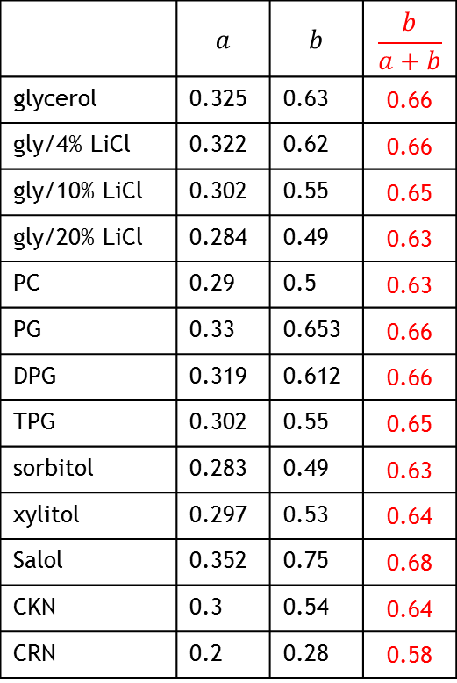
Correlation of α and fast process
 | $$a$$ | $$b$$ | $$\frac{b}{a+b}$$
glycerol | 0.325 | 0.63 | 0.66
gly/4% LiCl | 0.322 | 0.62 | 0.66
gly/10% LiCl | 0.302 | 0.55 | 0.65
gly/20% LiCl | 0.284 | 0.49 | 0.63
PC | 0.29 | 0.5 | 0.63
PG | 0.33 | 0.653 | 0.66
DPG | 0.319 | 0.612 | 0.66
TPG | 0.302 | 0.55 | 0.65
sorbitol | 0.283 | 0.49 | 0.63
xylitol | 0.297 | 0.53 | 0.64
Salol | 0.352 | 0.75 | 0.68
CKN | 0.3 | 0.54 | 0.64
CRN | 0.2 | 0.28 | 0.58
P. Lunkenheimer, M. Köhler, S. Kastner, and A. Loidl, unpublished

Slide 21
Summary
Data on fast process for 14 (structural) glass formers
Reasonable description by idealized MCT (more sophisticated analysis still missing for most materials)
Glycerol with LiCl: Broadening of loss minimum
Correlation of α and fast process - explanation?

Slide 22
Thank you!

